Slide 2
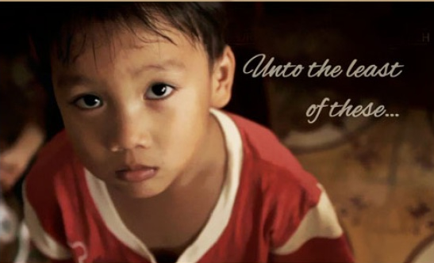
“Near His Heart”
God’s Restorative Care for Orphans and the Fatherless
By Carol Reid

Slide 3
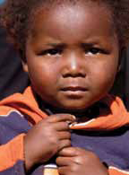
near his heart
God Restores Protection
Pointer of truth: “The Lord preserveth the strangers;
he relieveth the fatherless and widow: but the way of the
wicked he turneth upside down” (Psalm 146:9).

Slide 4
near his heart
God Restores Protection
rule of thumb: God Himself promises to protect and uphold orphans—even 21st century orphans, as diverse and unique as they may appear.

Slide 5
near his heart
God Restores Protection
God’s Word offers protection:
Unborn orphans
Foster children
Homeless children
Gang members
Lonely kids

Slide 6

What orphan needs your care today?

Slide 7

near his heart
God Restores Property
Pointer of truth: “Defend
the poor and fatherless: do
justice to the afflicted and
needy” (Psalm 82:3).

Slide 8

near his heart
God Restores Property
rule of thumb: God’s Word ensures justice for
orphans, helping them reclaim
what is rightfully theirs.

Slide 9
near his heart
God Restores Property
When there is trouble or
injustice, we need to bring it
to the authorities.
God hears us when
we stand up for justice.
We also need to be open
to compromise in working with
others.

Slide 10
We must speak up for what is right, using the channels open to us.

Slide 11
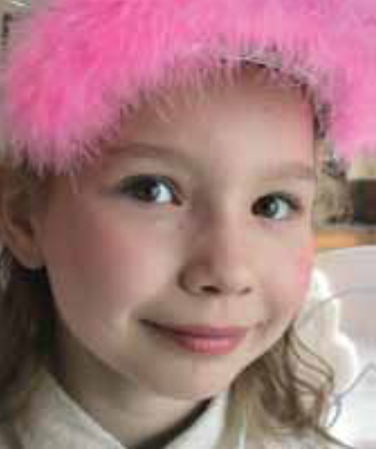
near his heart
God Restores his people
Pointer of truth: “Defend
the poor and fatherless: do
justice to the afflicted and
needy” (Psalm 82:3).

Slide 12
near his heart
God Restores his people
rule of thumb: The same God who used an orphan girl to save lives, expose evil and ensure the continuance of His people, includes you in His plan.

Slide 13
near his heart
God Restores his people
Esther’s story is one of courage
and justice and God’s protection.
An orphaned girl became God’s provision for protecting all of Israel.
If you feel outcast and alone, remember God has a plan.

Slide 14
Today, what has God put you in place to do?

Slide 15
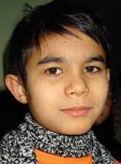
near his heart
God Restores the Palace
Pointer of truth: “When my father and my mother
forsake me, then the Lord will take me up” (Psalm 27:10).

Slide 16
near his heart
God Restores the palace
rule of thumb: All of us, orphaned, crippled and
impoverished by sin, can find restoration, meaning for life
and a place in God’s Kingdom through salvation in Christ.

Slide 17
near his heart
God Restores the Palace
When you are feeling forsaken, alone, uncertain, orphaned—He will
take you in His arms and hold you
and protect you and provide for you.

Slide 18
God is near and He cares for you.

