Slide 1
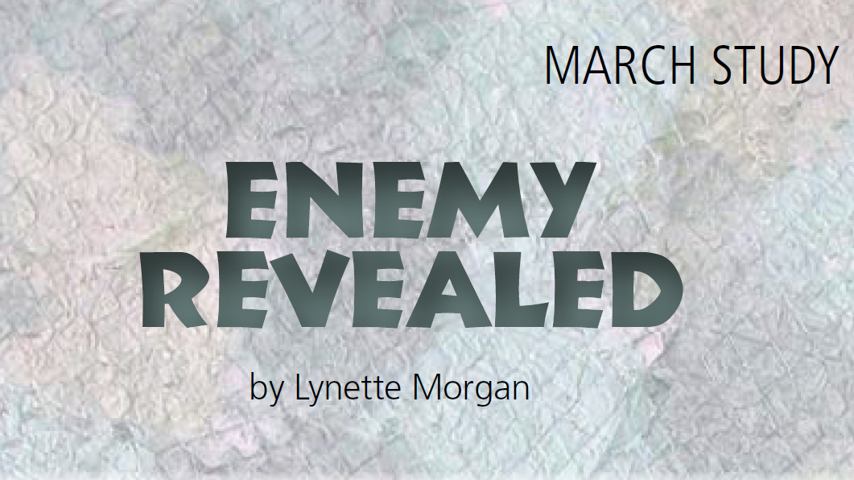

Slide 2
ENEMY REVEALED
War is horrendous
Spiritual warfare was rarely, if ever, mentioned
Our enemy is not communism, terrorism or radicals
Jesus - our enemy is “the ruler of this world”
We don’t want this battle

Slide 3
ENEMY REVEALED
Identifying the Enemy
HANDPRINT: Knowing our enemy helps us remain victorious in warfare.
HANDWRITING ON THE HEART (to be memorized): “…greater is he that is
in you, than he that is in the world” (1 John 4:4).

Slide 4
ENEMY REVEALED
Identifying the Enemy
Lucifer, son of the
morning star, became Satan, father of the night and ruler over the kingdom of
darkness.
The story begins like a
fairytale
Lucifer – the chosen one
Lucifer wanted more - pride
Lucifer’s many names
Prince of this world
He has power, but he is not all
powerful.
God keeps Satan on a short leash.

Slide 5
FROM HIS HAND: Read Isaiah 14:12-15 and Ezekiel 28:11-19 for an early history of the Enemy..
TRACE HIS HAND: Match the title of the Enemy with the work he does.
HIS HAND IN MY LIFE
___ 1. Prince of the Power of the Air
___ 2. God of this World
___ 3. Ruler of Darkness
___ 4. (like a) Roaring Lion
___ 5. Man of Sin, Son of Perdition
a. blinds us from believing
b. devours, destroys
c. exalts himself
d. fulfills the desires of the flesh
e. weakens, unable to stand

Slide 6
—Do you believe in a real devil? Fifty percent of born-again Christians say they did not believe in the existence of Satan. Why is this?
—How does our belief about Satan affect our spiritual life?
—How can we teach our children of the reality of the devil without scaring them to death?
Each week resolve to memorize one verse. Begin with 1 John 4:4. Say it over, first thing upon arising and last thing before sleeping.

Slide 7
TOUCHPOINT:
I pledge allegiance to the Christian flag,
And to the Savior, for whose Kingdom it stands.
One Savior, crucified, risen and coming again
With life and liberty for all who believe.
THINK: Who in her right mind would pledge allegiance to a defeated foe?

Slide 8
ENEMY REVEALED
The Battle
HANDPRINT: A war exists between the kingdoms of light and darkness.
HANDWRITING ON THE HEART (to be memorized): “For though we walk
in the flesh, we do not war after the flesh” ( 2 Corinthians 10:3).

Slide 9
ENEMY REVEALED
The Battle
Fight the good fight
with all thy might.
Christ is thy strength
and Christ thy right.
The seed of war was born
in Heaven, but it was on
earth that it took root and spread.
Adam and Eve
Enemy’s plan has not changed
Bondage of the Israelites
Efforts to destroy the Jewish race
God is orchestrating every scene

Slide 10
FROM HIS HAND: Read 1 Chronicles. 21:1; Job 1:12; Luke: 22:31; 1 Thessalonians 3:5-8; 1 John 2:14.
TRACE HIS HAND: The Enemy works through God’s people. Identify some of these people by using the Scriptures above to fill in the blanks

Slide 11
The Enemy had to receive God’s permission in order to afflict
_________. (What about you?)
The Enemy sifted ____________ like wheat, but Jesus prayed that his
faith would remain strong. (Have you been sifted?)
The Enemy had to receive God’s permission in order to afflict
_________. (What about you?)
The Enemy sifted ____________ like wheat, but Jesus prayed that his
faith would remain strong. (Have you been sifted?)

Slide 12
News of the faith and joy of the _____________________ (and their resistance to the tempter) brought comfort to Paul and his ministry partners in their afflictions and distress. (Would others find comfort in hearing of you?)
__________ __________ were commended because they had overcome the wicked one. (Are you overcoming him?)
Satan stood up and provoked (tempted) ____________ to sin. (How
does he tempt you?)

Slide 13
LEND A HAND:
—It’s a scary thought that the Enemy uses us. Can he work through us without our knowledge?
—Is it possible to have dual citizenship in both the kingdom of darkness and the kingdom of light?
—What responsibilities do we have as citizens of the Kingdom of Heaven?
LIFT YOUR HANDS:
Each week memorize the Handwriting verse.
Ask God to help you retain His Word.
Pray the Holy Spirit would help you recognize the evil influences
in your life.
Claim the victory through the power of the Word.
TOUCHPOINT: The battle belongs to the Lord.

Slide 14
ENEMY REVEALED
The Battlefield
HANDPRINT: In this war for human souls, the battlefield is the mind.
HANDWRITING ON THE HEART (to be memorized): “And be not conformed
to this world: but be ye transformed by the renewing of your mind, that ye may prove
what is that good, and acceptable, and perfect, will of God” (Romans 12:2).

Slide 15
ENEMY REVEALED
The Battlefield
The mind has no
garbage disposal. We must take an aggressive
role in bringing into
captivity every thought
for Christ.
Whosoever and His Heart
House
King’s promise
Instruction manual
House overrun with intolerable guests
Application
King and Enemy
Mind is a battlefield

Slide 16
ENEMY REVEALED
The Battlefield
The mind has no
garbage disposal. We must take an aggressive
role in bringing into
captivity every thought
for Christ.
A Woman’s mind
Mental computer
– never shuts down
God reprograms our thought life
Bring every thought into captivity
Uncontrolled thoughts,
Self-centered indulgences
Hangovers from a former lifestyle
“Be filled with the Spirit.”

Slide 17
FROM HIS HAND: Read Job 38:36; Isaiah 26:3; Luke 12:29; Romans 12:16; Philippians 2:5; Colossians 3:2; Hebrews 8:10. What do these Scriptures say about our thought life?
TRACE HIS HAND: Picture your heart house. Does it need a thorough cleaning? Take these steps to drive out all unwelcome guests.

Slide 18
P__________ (1 Thessalonians 5:17) Ask God to help control your
thinking. It’s only the first step; there’s more.
M_____________________ upon God’s W________ (Psalm 19:14). We can saturate our minds with Scripture; think God’s thoughts after Him. Read the Psalms aloud to the Lord.
M__________________ Scripture (Psalm 119:11).

Slide 19
Journal your p_________________ (1 Timothy 4:15). Discover the face of God in all your ups and downs. Writing it down helps you remember.
Become a___________________ (Romans 14:12). Jesus never sent a
disciple on a mission alone. We need each other.

Slide 20
LEND A HAND:
—The mind is an awesome thing.
—The mind is a computer.
—The mind computer stores data.
LIFT YOUR HANDS:
Ask God to transform your thought life.
Pray Psalm 19:14: “Let the words of my mouth and the meditation of my heart be acceptable in Your sight, O Lord, my strength and my Redeemer.”
TOUCHPOINT: The mind has no garbage disposal.

Slide 21
ENEMY REVEALED
Enemy Weapons
HANDPRINT: Recognize the weapons the Enemy uses to derail Christians.
HANDWRITING ON THE HEART (to be memorized): “But if our gospel be
hid, it is hid to them that are lost: In whom the god of this world hath blinded the
minds…” ( 2 Corinthians 4:3).

Slide 22
ENEMY REVEALED
When the
Enemy tempts us,
he shows us the
worm—but not the
Hook behind that worm.
The Word of God
helps us see
the hook.
Enemy Weapons
“the Enemy attacks our minds
by despoiling the Christian of
his wealth, decoying him from his walk, and
disabling the Christian for his warfare.”
Ruth Paxton, in her book, The
Wealth, Walk and Warfare of the
Christian

Slide 23
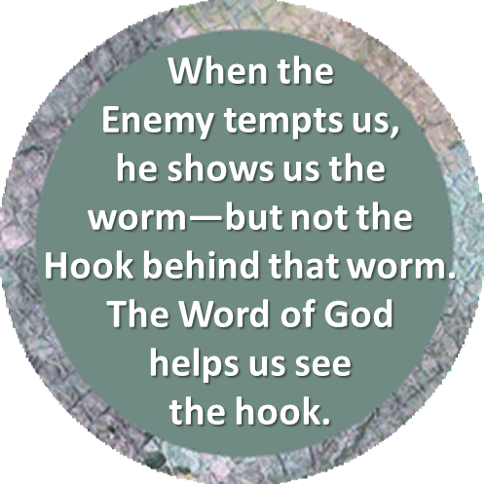
ENEMY REVEALED
Enemy Weapons
Deceit – the enemy’s
favorite weapon
“angel of light”
Second weapon - temptation
See the worm, but not the hook
Third weapon - accusations
Feelings of unworthiness
Guilt
Defeat or self-hatred
“let him that thinketh he standeth take heed lest he fall”(1 Corinthians 10:12)

Slide 24
FROM HIS HAND: Bank tellers focus on the genuine. The
more we focus on Jesus, the less dangerous the Enemy becomes. Let’s focus on the sevenfold character of the Christian’s walk as found in the Book of Ephesians. Read Ephesians 4:3, 17; 5:3-5, 15, 19-20, 30.
TRACE HIS HAND: When you read the passages above, did you spot these characteristics? Following each one, write down one area where you need work. For example, following Unity, you might write “in my marriage” or “in my committee meeting.”

Slide 25
TRACE HIS HAND: When you read the passages above, did you spot these characteristics? Following each one, write down one area where you need work. For example, following Unity, you might write “in my marriage” or “in my committee meeting.”
Unity
Holiness
Love
Light
Wisdom
Praise
Harmony

Slide 26
LEND A HAND:
—Satan uses weapons of deception, temptation and accusation.
Share your experiences in each of these areas.
—How did you identify these when you experienced them, and how
did you gain victory over them?
—Are you currently feeling the brunt of these weapons?
—Is someone you know facing similar attacks?
—Enlist women in a special prayer for those in the midst of the battle.

Slide 27
LIFT YOUR HANDS:
It’s a wicked world out there. Jesus chose to keep us in the world in the midst of the evil; at the same time, He prayed we would not succumb to it.
Pray that He would be strong in you and enable you to be victorious over the forces of darkness.
Ask Him to help us live in the world without being of the world.
TOUCHPOINT: Near, so very near to God, nearer I could not be;
For in the person of His Son, I’m just as near as He.

