Slide 1
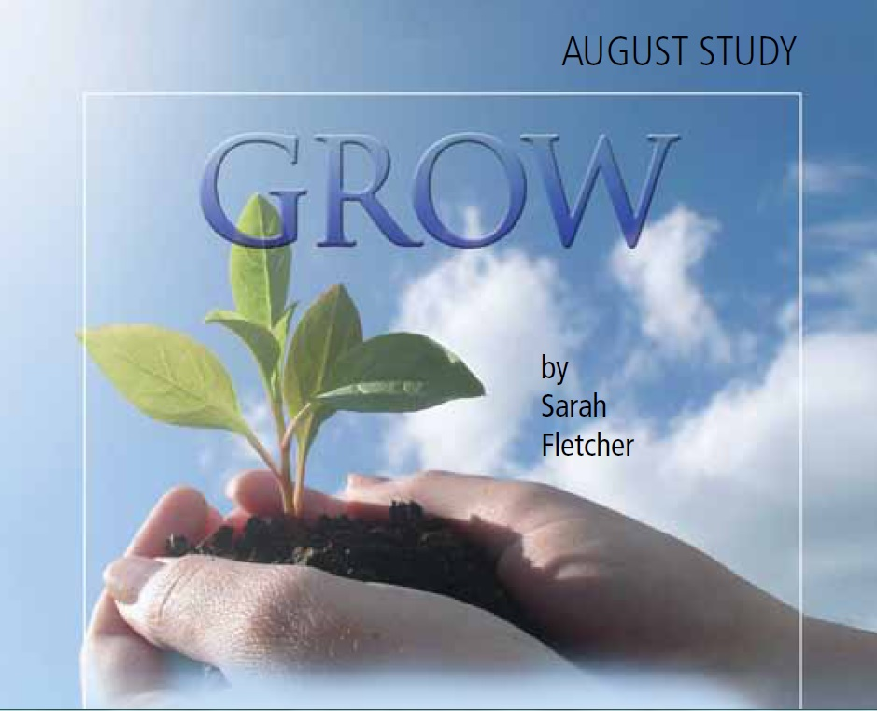

Slide 2
As with so many other facets of the Christian life, grace cannot remain static.
“Grace meets you where you are, but loves you way too much to let you stay there.”
A. W. Pink wrote, “Growth in grace is growth downward.”

Slide 3
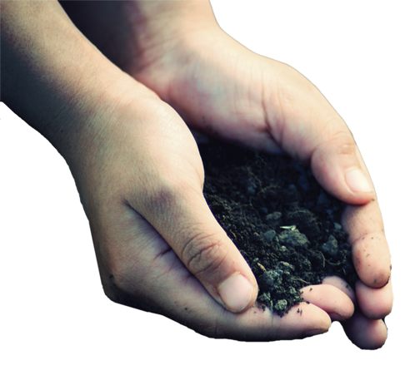
GROW
In Knowledge and Truth
HANDWRITING ON THE HEART: “Grace and peace be multiplied unto you through the knowledge of God, and of Jesus our Lord, according as his divine power hath given unto us all things that pertain unto life and godliness, through the knowledge of him that hath called us to glory and virtue” (2 Peter 1:2-3).
HANDPRINT: The grace we offer others, we often find difficult to extend to ourselves. Yet, the God of all grace seeks our restoration and calls us to follow Him.

Slide 4
GROW… In Knowledge and Truth
“All grace grows as love to the Word of God grows.” —Phillip Henry
The way to spot error, comes in knowing truth.
To avoid these pitfalls, our best defense is saturating ourselves in the Word.
We need to recognize some predictable methods and tactics of false teachers detailed in 2 Peter 2.
Money, Fame and Power.
Sense and Sensuality.
Promises, Promises.
Looking for Trouble.

Slide 5
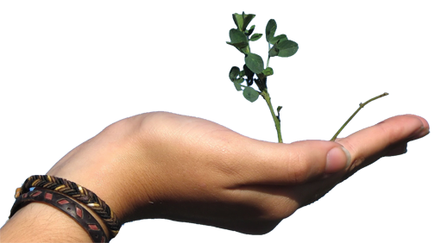
GROW
In Holiness
HANDWRITING ON THE HEART: “But as he which hath called you is holy, so be ye holy in all manner of conversation; because it is written, Be ye holy; for I am holy “ (1 Peter 1:15-16).
HANDPRINT: We grow in grace as we answer God’s call to holiness. Holiness involves yielding ourselves to the Spirit and following Christ’s example.

Slide 6
GROW… In Holiness
“The saints shall persevere in holiness, because God perseveres in grace.”
Holiness may be one of the most misunderstood terms in the church world.
What is true holiness?
Holiness is a longing.
Holiness is a calling.
Holiness is a lifestyle.
Holiness demands diligence on our part.
We obey God’s laws, we add virtue
We learn more of Him, knowledge
We need more patience
We desire the mind of Christ, Godliness
We respond in kindness and love

Slide 7
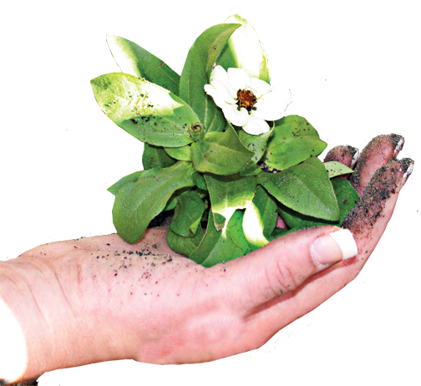
GROW
Through Suffering
HANDWRITING ON THE HEART: “But the God of all grace, who hath called us unto his eternal glory by Christ Jesus, after that ye have suffered a while, make you perfect, stablish, strengthen, settle you” (1 Peter 5:10).
HANDPRINT: We grow in grace as we follow the example of Christ in our response to persecution and suffering.

Slide 8
GROW… Through Suffering
“Christians are like tea bags—you have to put them in hot water before you know how strong they are.”
More Christians martyred in the 20th century than in all previous centuries combined
Suffering is neither desirable nor easy.
Suffering defines us.
Suffering refines us.
Suffering aligns us.
Suffering places us on a path of opportunity.

Slide 9
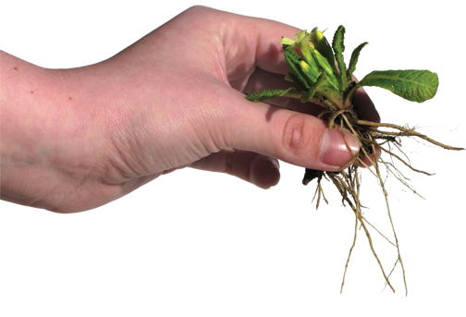
GROW
In Hope Of His Coming
HANDWRITING ON THE HEART: “Wherefore gird up the loins of your mind, be sober, and hope to the end for the grace that is to be brought unto you at the revelation of Jesus Christ” (1 Peter 1:13).
HANDPRINT: We grow in grace as we diligently live and serve in anticipation of Christ’s return.

Slide 10
GROW… In Hope Of His Coming
“And I shall see Him face to face, and tell the story,—Saved by grace.” —Fannie Crosby
The tougher the times, the greater Heaven’s appeal. In the throes of persecution, early Christians longed for Christ’s return.
These phrases encapsulate Peter’s message.
Wait and hope.
Hope and grow.
Waiting for His return, hoping in His promise, grow in grace .

