Slide 1
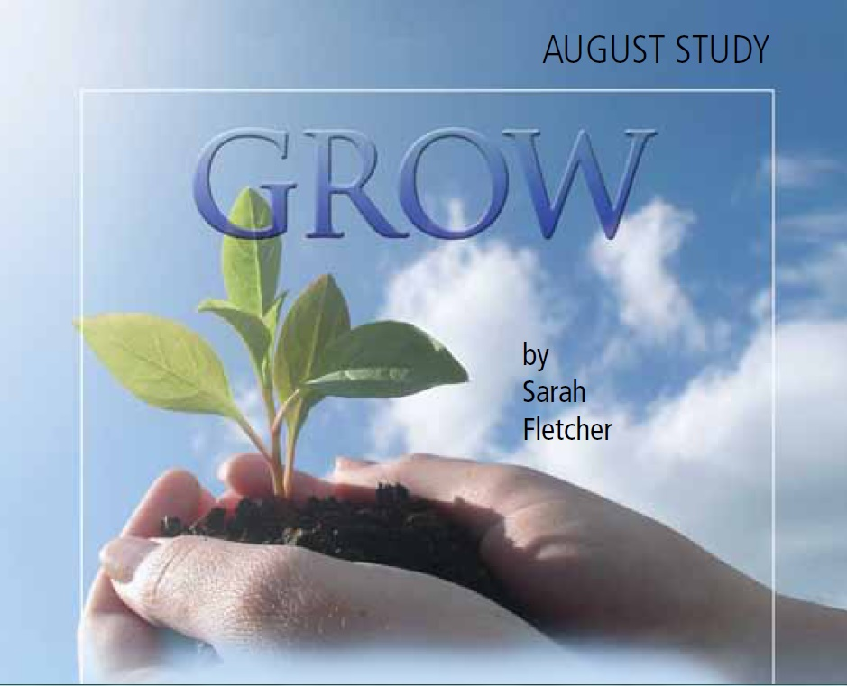

Slide 2
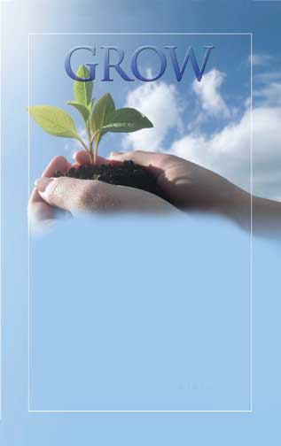
As with so many other facets of the Christian life, grace cannot remain static.
“Grace meets you where you are, but loves you way too much to let you stay there.”
A. W. Pink wrote, “Growth in grace is growth downward.”

Slide 3
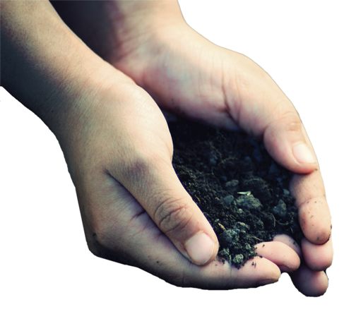
GROW
In Knowledge and Truth
HANDWRITING ON THE HEART: “Grace and peace be multiplied unto you through the knowledge of God, and of Jesus our Lord, according as his divine power hath given unto us all things that pertain unto life and godliness, through the knowledge of him that hath called us to glory and virtue” (2 Peter 1:2-3).
HANDPRINT: The grace we offer others, we often find difficult to extend to ourselves. Yet, the God of all grace seeks our restoration and calls us to follow Him.

Slide 4
GROW… In Knowledge and Truth
“All grace grows as love to the Word of God grows.” —Phillip Henry
The way to spot error, comes in knowing truth.
To avoid these pitfalls, our best defense is saturating ourselves in the Word.
We need to recognize some predictable methods and tactics of false teachers detailed in 2 Peter 2.
Money, Fame and Power.
Sense and Sensuality.
Promises, Promises.
Looking for Trouble.

Slide 5
GROW… In Knowledge and Truth
HIS HAND IN MY LIFE
FROM HIS HAND: Read 2 Peter 2.
TRACE HIS HAND: In this chapter, Peter uses colorful, descriptive terms for false teachers. List as many as you find.
According to 2 Peter 2:14, 18, who are the primary targets of false teachers?
What is the lure of false teachers (2:19)?

Slide 6
GROW… In Knowledge and Truth
HIS HAND IN MY LIFE
In Peter’s day, false teachings centered around the deity of Christ and the end times. How should knowing truths from God’s Word help us combat these current false teachings?
God just wants us to be happy (1 Peter 4:16; 2 Timothy 3:12).
Prosperity, success, and health—proofs of God’s favor and results of our faith—can be obtained as we speak them into our lives (James 2:5; Luke 12:15).
God loves people too much to send them to hell (Romans 1:20; Revelation 21:7-8).
The Bible is a spiritual book, but not a trustworthy source in matters of science and history (2 Timothy 3:16).

Slide 7
GROW… In Knowledge and Truth
HIS HAND IN MY LIFE
LEND A HAND: What are some ways churches can better teach young Christians and avoid the influence of false teachers in their lives?
TOUCHPOINT: ”Grace is the central invitation to life and the final word. It’s the beckoning nudge and the overwhelming, undeserved mercy that urges us to change and grow, and then gives us the power to pull it off.” —Tim Hansel

Slide 8
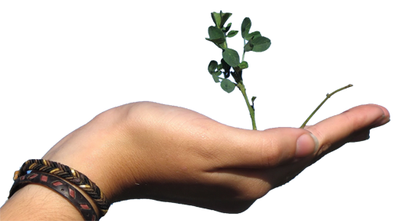
GROW
In Holiness
HANDWRITING ON THE HEART: “But as he which hath called you is holy, so be ye holy in all manner of conversation; because it is written, Be ye holy; for I am holy “ (1 Peter 1:15-16).
HANDPRINT: We grow in grace as we answer God’s call to holiness. Holiness involves yielding ourselves to the Spirit and following Christ’s example.

Slide 9
GROW… In Holiness
“The saints shall persevere in holiness, because God perseveres in grace.”
Holiness may be one of the most misunderstood terms in the church world.
What is true holiness?
Holiness is a longing.
Holiness is a calling.
Holiness is a lifestyle.
Holiness demands diligence on our part.
We obey God’s laws, we add virtue
We learn more of Him, knowledge
We need more patience
We desire the mind of Christ, Godliness
We respond in kindness and love

Slide 10
GROW… In Holiness
HIS HAND IN MY LIFE
FROM HIS HAND: Read 1 Peter 1:15-16; 2 Peter 1.
TRACE HIS HAND: God calls us all to holiness. Peter’s writings affirm this. From these verses, list the groups or individuals described as holy.
1 Peter 2:5
1 Peter 2:9
1 Peter 3:5
2 Peter 1:21
2 Peter 3:2
How would you define holiness?

Slide 11
GROW… In Holiness
HIS HAND IN MY LIFE
Compare 1 Peter 1:15-16 with Titus 2:11-12. How are grace and holiness connected?
Read and consider 2 Peter 1:8-11. Is it possible to grow in grace without holiness?
List the growth elements (“add-ons” to faith) mentioned in 2 Peter 1:5-7. Circle any that are definite areas needing growth in your life.
Pray, committing these areas to His control and asking God to help to grow.

Slide 12
GROW… In Holiness
HIS HAND IN MY LIFE
LEND A HAND: In our churches, we’ve often placed the cart before the horse, emphasizing outward conformity over inward change (looking holy rather than being holy). This typically results in hypocrisy.
What steps can we take to resolve this situation without diminishing the importance of righteous living?

Slide 13
GROW… In Holiness
HIS HAND IN MY LIFE
TOUCHPOINT: “... the pursuit of holiness must be anchored in grace; otherwise it is doomed to failure.” —Jerry Bridges
“Grace is not simply leniency when we have sinned. Grace is the enabling gift of God not to sin. Grace is power, not just pardon.” —John Piper

Slide 14
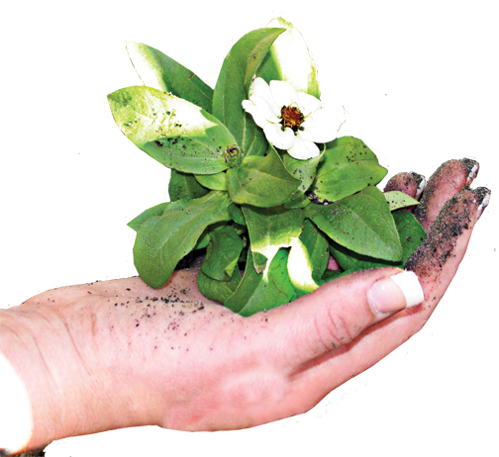
GROW
Through Suffering
HANDWRITING ON THE HEART: “But the God of all grace, who hath called us unto his eternal glory by Christ Jesus, after that ye have suffered a while, make you perfect, stablish, strengthen, settle you” (1 Peter 5:10).
HANDPRINT: We grow in grace as we follow the example of Christ in our response to persecution and suffering.

Slide 15
GROW… Through Suffering
“Christians are like tea bags—you have to put them in hot water before you know how strong they are.”
More Christians martyred in the 20th century than in all previous centuries combined
Suffering is neither desirable nor easy.
Suffering defines us.
Suffering refines us.
Suffering aligns us.
Suffering places us on a path of opportunity.

Slide 16
GROW… Through Suffering
HIS HAND IN MY LIFE
FROM HIS HAND: Read 1 Peter 2:18-25; 3:13-18; 4:1, 12-19
TRACE HIS HAND: Christ is our example in suffering. According to 1 Peter 2:21-24, how did He respond to false accusations and undeserved punishment?
Peter was no stranger to suffering. Skim these verses and write down any suffering or persecution he faced along with the incident or source of trouble.
Acts 4:3, 21 (see 3:11 for incident) Acts 5:17
Acts 5:40 Acts 12:1-4
According to 1 Peter 4:15, a believer’s suffering should never stem from what?

Slide 17
GROW… Through Suffering
HIS HAND IN MY LIFE
From these verses, list positive emotional responses we can share when we face suffering as a Christian.
1 Peter 1:6-8
1 Peter 3:14; 4:14
1 Peter 4:16
How do you typically respond to ridicule or criticism of your faith?

Slide 18
GROW… Through Suffering
HIS HAND IN MY LIFE
LEND A HAND: Have you ever experienced persecution as a Christian or known someone who has? If so, how did this affect this person’s faith?
Spend time in corporate prayer for the persecuted church around the world.
TOUCHPOINT: ”Grace doesn’t depend on suffering to exist, but where there is suffering, you will find grace in many facets and colors.” —Wm. Paul Young

Slide 19
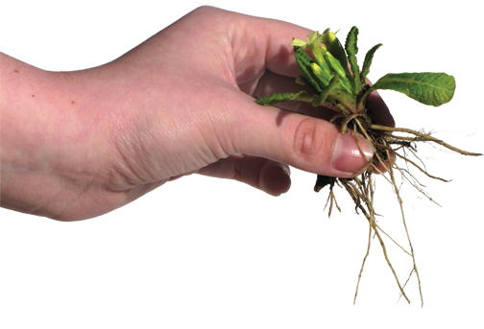
GROW
In Hope Of His Coming
HANDWRITING ON THE HEART: “Wherefore gird up the loins of your mind, be sober, and hope to the end for the grace that is to be brought unto you at the revelation of Jesus Christ” (1 Peter 1:13).
HANDPRINT: We grow in grace as we diligently live and serve in anticipation of Christ’s return.

Slide 20
GROW… In Hope Of His Coming
“And I shall see Him face to face, and tell the story,—Saved by grace.” —Fannie Crosby
The tougher the times, the greater Heaven’s appeal. In the throes of persecution, early Christians longed for Christ’s return.
These phrases encapsulate Peter’s message.
Wait and hope.
Hope and grow.
Waiting for His return, hoping in His promise, grow in grace .

Slide 21
GROW… In Hope Of His Coming
HIS HAND IN MY LIFE
FROM HIS HAND: Read 1 Peter 1:3-13; 2 Peter 3.
TRACE HIS HAND: Peter listened well as Christ shared about the end times and His return. This teaching, known as the Olivet Discourse, is found in Matthew 24. Skim this chapter, then reread 2 Peter 3, looking for similarities. Record these.
How much of what you hear (or read) in Scripture do you retain?

Slide 22
GROW… In Hope Of His Coming
HIS HAND IN MY LIFE
In 1 Peter 1:13 and 1 Peter 4:7, we find the word “sober” used in relation to Christ’s coming. Read and reflect on these verses. Why is seriousness important? How serious are you about Christ’s return?
According to 2 Peter 3:12 and 14, what responses should knowing about Christ’s return produce in our lives?

Slide 23
GROW… In Hope Of His Coming
HIS HAND IN MY LIFE
LEND A HAND: Reflect back over this summer’s Bible study. Has your view or understanding of grace changed in any way? If so, how? What difference will this make in your life?
TOUCHPOINT: “ . . .until the day when God shall deign to reveal the future to man, all human wisdom is summed up in these two words— ’Wait and hope.’” —Alexander Dumas

