Slide 2
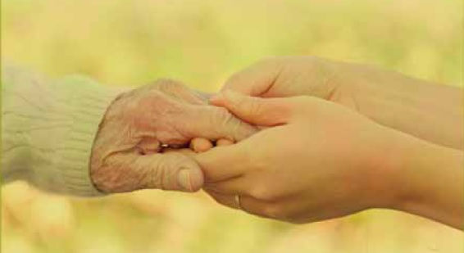
Grace is not just in the knowing; grace involves showing and extending that same unmerited favor to others.
What does grace look like as we live it out in the day to day?
Art design from the gracious hands of Teresa Smith, First FWB WAC, Pikeville, Kentucky.

Slide 3
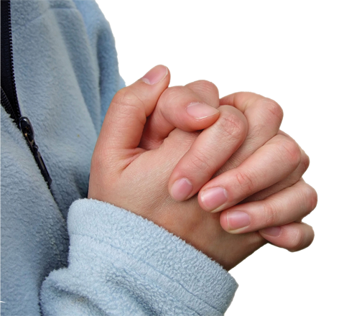
SHOW
Grace to Ourselves
HANDWRITING ON THE HEART: “But the God of all grace, who hath called us unto his eternal glory by Christ Jesus, after that ye have suffered a while, make you perfect, stablish, strengthen, settle you” (1 Peter 5:10).
HANDPRINT: The grace we offer others, we often find difficult to extend to ourselves. Yet, the God of all grace seeks our restoration and calls us to follow Him.

Slide 4
Psychologists share that a man’s mind takes snapshots, while a woman’s brain records videos.
Peter carried a large album of snapshot of failures
Peter fished all night and caught nothing, then Jesus extended an invitation.
Jesus questioned Peter’s passion. “Do you love me?”
Christ asks the same of us.
“Follow Me.” Peter did. Will you?

Slide 5
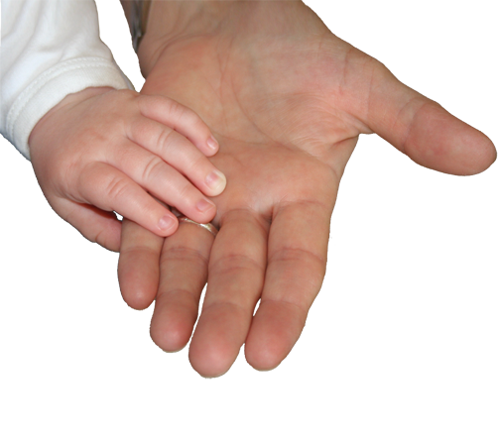
SHOW
Grace Within our Families
HANDWRITING ON THE HEART: “Likewise, ye husbands, dwell with them according to knowledge, giving honour unto the wife, as unto the weaker vessel, and as being heirs together of the grace of life; that your prayers be not hindered” (1 Peter 3:7).
HANDPRINT: Homes can be places of grace as we accept God’s design for the family, honor and respect one another and live in obedience to His Word.

Slide 6
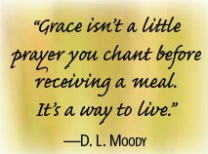
Challenges of family life
Peter’s wife required plenty of grace
Husbands may come to know Christ – “without ta word,”
Husbands should live with wives “according to knowledge”.
Live in accordance with God’s family design

Slide 7
SHOW
Grace to Other Believers
HANDWRITING ON THE HEART: “As every man hath received the gift, even so minister the same one to another, as good stewards of the manifold grace of God” (1 Peter 4:10).
HANDPRINT: Showing grace among believers involves love, humility, acceptance, hospitality, genuineness, and blessing others.

Slide 8
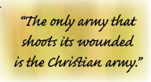
Rally together under the umbrella of grace
Principles for gracious living
Grace requires love.
Grace mirrors humility.
Grace acknowledges diversity.
Grace extends hospitality.
Grace defies hypocrisy.
Grace offers blessings.

Slide 9
SHOW
Grace to the World
HANDWRITING ON THE HEART: “But sanctify the Lord God in your hearts: and be ready always to give an answer to every man that asketh you a reason of the hope that is in you with meekness and fear” (1 Peter 3:15).
HANDPRINT: We show grace to the world through both words and actions.

Slide 10
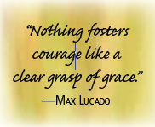
Show and tell
Showing grace involves more than random acts of kindness,
Live Honorably.
Submit Willingly.
Choose Wisely.
Respect Equally.
Answer readily.
SHOW GRACE

