Slide 2
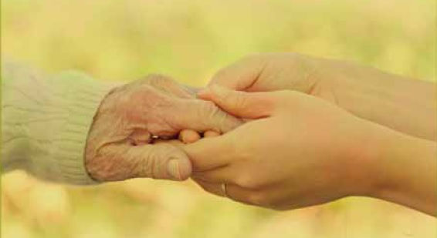
Grace is not just in the knowing; grace involves showing and extending that same unmerited favor to others.
What does grace look like as we live it out in the day to day?
Art design from the gracious hands
of Teresa Smith, First FWB WAC, Pikeville, Kentucky.

Slide 3
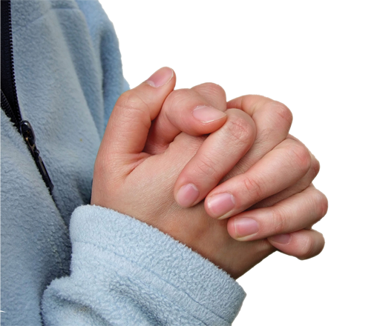
SHOW
Grace to Ourselves
HANDWRITING ON THE HEART: “But the God of all grace, who hath called us unto his eternal glory by Christ Jesus, after that ye have suffered a while, make you perfect, stablish, strengthen, settle you” (1 Peter 5:10).
HANDPRINT: The grace we offer others, we often find difficult to extend to ourselves. Yet, the God of all grace seeks our restoration and calls us to follow Him.

Slide 4
SHOW… Grace to Ourselves
Psychologists share that a man’s mind takes snapshots, while a woman’s brain records videos.
Peter carried a large album of snapshot of failures
Peter fished all night and caught nothing, then Jesus extended an invitation.
Jesus questioned Peter’s passion. “Do you love me?”
Christ asks the same of us.
“Follow Me.” Peter did. Will you?

Slide 5
SHOW… Grace to Ourselves
HIS HAND IN MY LIFE
FROM HIS HAND: Read 1 Peter 5; John 21
TRACE HIS HAND: Reread John 21. Write down any detail in this incident that might have triggered a past memory (good or bad) for Peter.
For example: verse 9: charcoal fire—reminiscent of the courtyard fire.
Jesus told Peter, “Feed My sheep …feed My lambs.” We see hints of this conversation in Peter’s admonitions to elders in 1 Peter 5:2-3.
Read these verses and record any similarities.

Slide 6
SHOW… Grace to Ourselves
HIS HAND IN MY LIFE
In these same verses we also see Peter’s motivation (The answer to Christ’s question, “Lovest thou me more than these?”). What phrases does Peter use to describe the loving way leaders should minister?
Continually reliving the past keeps us from being fully engaged in the present and also hinders our view of the future. How might showing God’s grace to yourself assist in finding balance and perspective?

Slide 7
SHOW… Grace to Ourselves
HIS HAND IN MY LIFE
LEND A HAND: How can we help those bound by past failure to recognize that grace abounds?
TOUCHPOINT: “All men who live with any degree of serenity live by some assurance of grace.” —Reinhold Niebuhr

Slide 8
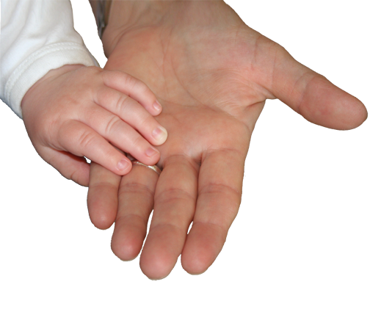
SHOW
Grace Within our Families
HANDWRITING ON THE HEART: “Likewise, ye husbands, dwell with them according to knowledge, giving honour unto the wife, as unto the weaker vessel, and as being heirs together of the grace of life; that your prayers be not hindered” (1 Peter 3:7).
HANDPRINT: Homes can be places of grace as we accept God’s design for the family, honor and respect one another and live in obedience to His Word.

Slide 9
SHOW… Grace Within our Families
Challenges of family life
Peter’s wife required plenty of grace
Husbands may come to know Christ – “without ta word,”
Husbands should live with wives “according to knowledge”.
Live in accordance with God’s family design

Slide 10
SHOW… Grace Within our Families
HIS HAND IN MY LIFE
FROM HIS HAND: 2 Peter 1; 1 Peter 3:1-12.
TRACE HIS HAND: What does grace look like in our homes? Much of that hinges on us as women. 1 Peter 3:1-12 describes the look of grace. Review the passage. List all the things grace is not, then list any grace components mentioned.
GRACE IS NOT… GRACE IS...

Slide 11
SHOW… Grace Within our Families
HIS HAND IN MY LIFE
In 1 Peter 3:6, Peter pointed to Sarah as an example of a submissive wife. Peter said we are Sarah’s daughters when we do well and are not afraid. Why do you think he mentions fear?
1 Peter 3:7 suggests the way we view or treat a spouse can directly affect our prayers. Why do you think this is so?
What are some major sources of conflict in your home? List one way you could approach each of these with grace?

Slide 12
SHOW… Grace Within our Families
HIS HAND IN MY LIFE
LEND A HAND: What are some unique challenges women with unsaved husbands face? Do you know of a husband who came to Christ because of his wife’s silent witness? Can a wife be obedient to Christ if she is not submissive to her husband?
TOUCHPOINT: “If you live grace and extend it freely in your home, the light of Jesus will shine from there into your community and everywhere you go.”
—Kevin Harney (Outreach Magazine)

Slide 13
SHOW
Grace to Other Believers
HANDWRITING ON THE HEART: “As every man hath received the gift, even so minister the same one to another, as good stewards of the manifold grace of God” (1 Peter 4:10).
HANDPRINT: Showing grace among believers involves love, humility, acceptance, hospitality, genuineness, and blessing others.

Slide 14
SHOW… Grace to Other Believers
Rally together under the umbrella of grace
Principles for gracious living
Grace requires love.
Grace mirrors humility.
Grace acknowledges diversity.
Grace extends hospitality.
Grace defies hypocrisy.
Grace offers blessings.

Slide 15
SHOW… Grace to Other Believers
HIS HAND IN MY LIFE
FROM HIS HAND: Read 2 Peter 2:1, 22; 1 Peter 3:8-12, 4:8-11
TRACE HIS HAND: Look up these passages concerning these six principles of gracious conduct toward believers. Write down your insights.
Love: 1 Peter 1:22; 1 Peter 3:8; 1 Peter 4:8.
Humility: 1 Peter 3:8; 1 Peter 5:5-6.
Acceptance: 1 Peter 3:8; 1 Peter 4:10-11.
Hospitality: 1 Peter 4:9.
Genuineness: Acts 15:10; 1 Peter 2:1.
Blessing: 1 Peter 3:8-11.

Slide 16
SHOW… Grace to Other Believers
HIS HAND IN MY LIFE
LEND A HAND: Read 2 Peter 3:15-16 and Galatians 2:1-2, 7-10.
Why is leadership style often misunderstood in the church?
How can we get past this and extend the right hand of fellowship to other Christians?
TOUCHPOINT: “By judging others we blind ourselves to our own evil and to the grace which others are just as entitled to as we are.” —Dietrich Bonhoeffer

Slide 17
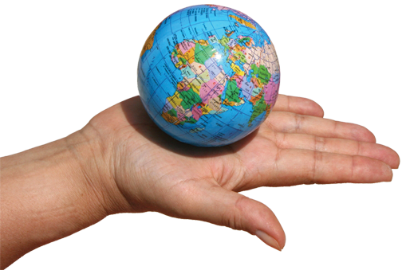
SHOW
Grace to the World
HANDWRITING ON THE HEART: “But sanctify the Lord God in your hearts: and be ready always to give an answer to every man that asketh you a reason of the hope that is in you with meekness and fear” (1 Peter 3:15).
HANDPRINT: We show grace to the world through both words and actions.

Slide 18
SHOW… Grace to the World
Show and tell
Showing grace involves more than random acts of kindness,
Live Honorably.
Submit Willingly.
Choose Wisely.
Respect Equally.
Answer readily.
SHOW GRACE

Slide 19
SHOW… Grace to the World
HIS HAND IN MY LIFE
FROM HIS HAND: Read 1 Peter 2:9-17
TRACE HIS HAND: Examine these principles from 1 Peter 2 and 3 for showing grace to unbelievers in our world. List at least one practical way this applies in your relationships with unbelievers. Then add one im-provement or a change you need to make in this area.
Live Honorably (2:12; 3:16)
Submit Willingly (2:13; 3:1)
Choose Wisely (1 Peter 2:16)
Respect Equally (1 Peter 2:17)
Answer Readily: (1 Peter 2:9; 3:15)

Slide 20
SHOW… Grace to the World
HIS HAND IN MY LIFE
LEND A HAND: If you’ve been a Christian for any length of time, you’ve probably observed a swing in the pendulum of evangelism methods—door-to-door evangelism, crusade evangelism, street evangelism, literature evangelism (tracts), friendship evangelism, lifestyle evangelism, servant evangelism. What method(s) are most familiar to you? Is any one better than another?
TOUCHPOINT: “Christians are God’s delivery people, through whom he does his giving to a needy world. We are conduits of God’s grace to others.” —Randy Alcorn

