Slide 1
Flex
your spiritual muscles.

Slide 2
rejoice

Slide 3
think

Slide 4
trust

Slide 5
do

Slide 6
Avoid Atrophy

Slide 7
Display your meeting information
on this slide

Slide 8
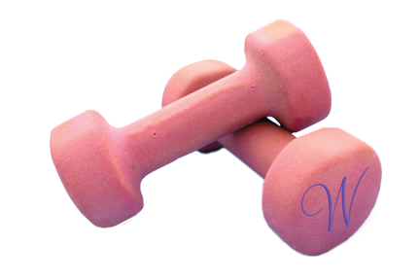
WOMEN NATIONALLY ACTIVE FOR CHRIST

