Slide 1

Praise Him in the Chaos

Slide 2
Chaos can be defined as a situation in which one is…..
*uncertain about what to do,
*unable to understand clearly,
*usually with unmet expectations.

Slide 3

Lost in this horrible pit?

Slide 4
Psalm 40:1-3
Read David’s heart-cry and song of praise after running for his life.
(2 Samuel 2:15-18)

Slide 5
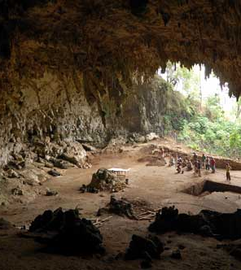
The horrible pit was a physical and spiritual wilderness where he waited patiently for God to help.

Slide 6
Chaos is the perfect and necessary backdrop for peace, resulting in praise. We surrender to God by trusting in the chaos, after deliverance, praise is used for the benefit of others.

Slide 7
1 Kings 19:1-18
Elijah is also running for his life. He cried for God to let him die. But after God steadied him and established his goings, He sent Elijah on a new mission.

Slide 8

Think about the tactics of the
enemy to send us running.
Discuss some examples from our own lives.

Slide 9
Hebrews 10:5-10
Jesus struggled with the uncertainty of the impending death He had to face and cried for God to let there be another way.

Slide 10
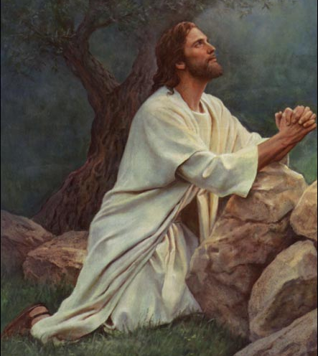
He ended His prayer in acceptance of carrying out God’s will.

Slide 11
Out of this dark confusion came the greatest praise song ever sung, a new song—an ultimate sacrifice of praise.
Praise His glorious name!

Slide 12
There is a real enemy, a predator.
There is a real struggle with the horrible pit.
There is a Proponent, the Great Rescuer—a trustworthy God.
He gives us a gift—purpose, our response of praise for His wonders and His very character.

Slide 13
We offer praise so many will see what He has done and be amazed.
Then they will put their trust in the Lord.

Slide 14
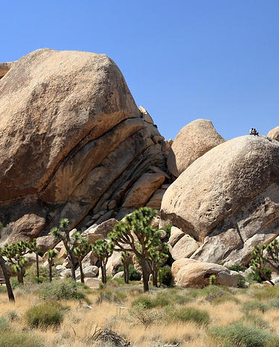
If not us, then the rocks will cry out.
(Luke 19:40)

Slide 15

In partnership
with….

