Slide 1
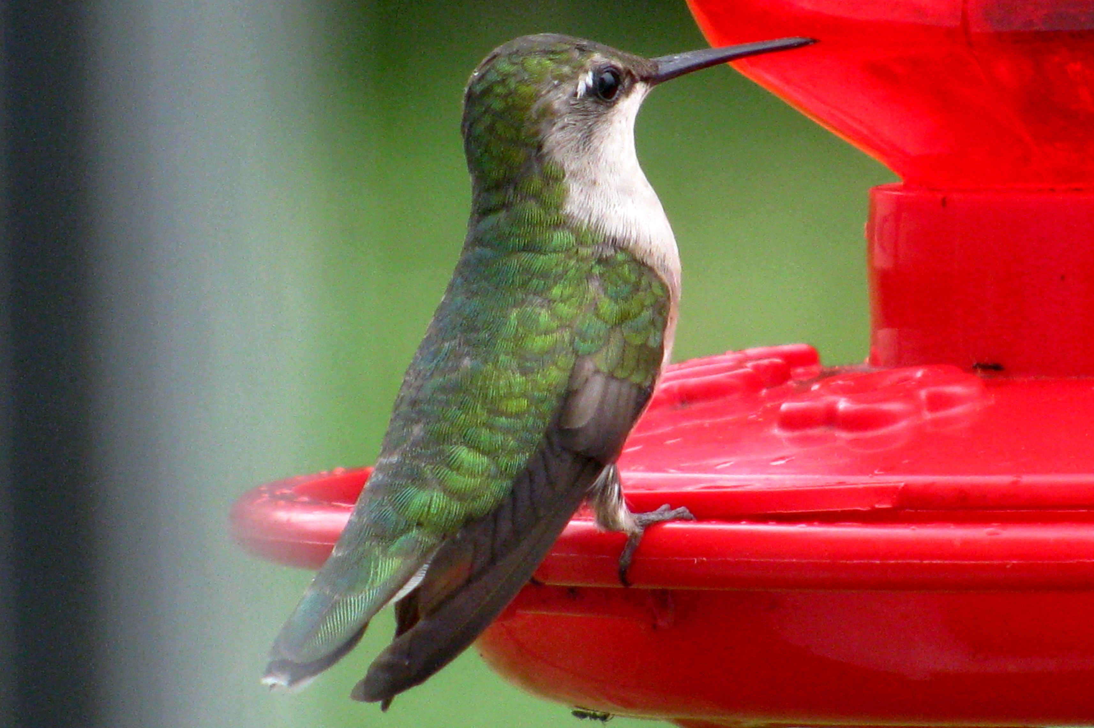
Praise Him in Creation
Pictures provided by Genevieve Waddell

Slide 2
God’s creation can be described with a library full of words and yet leaves us speechless.

Slide 3
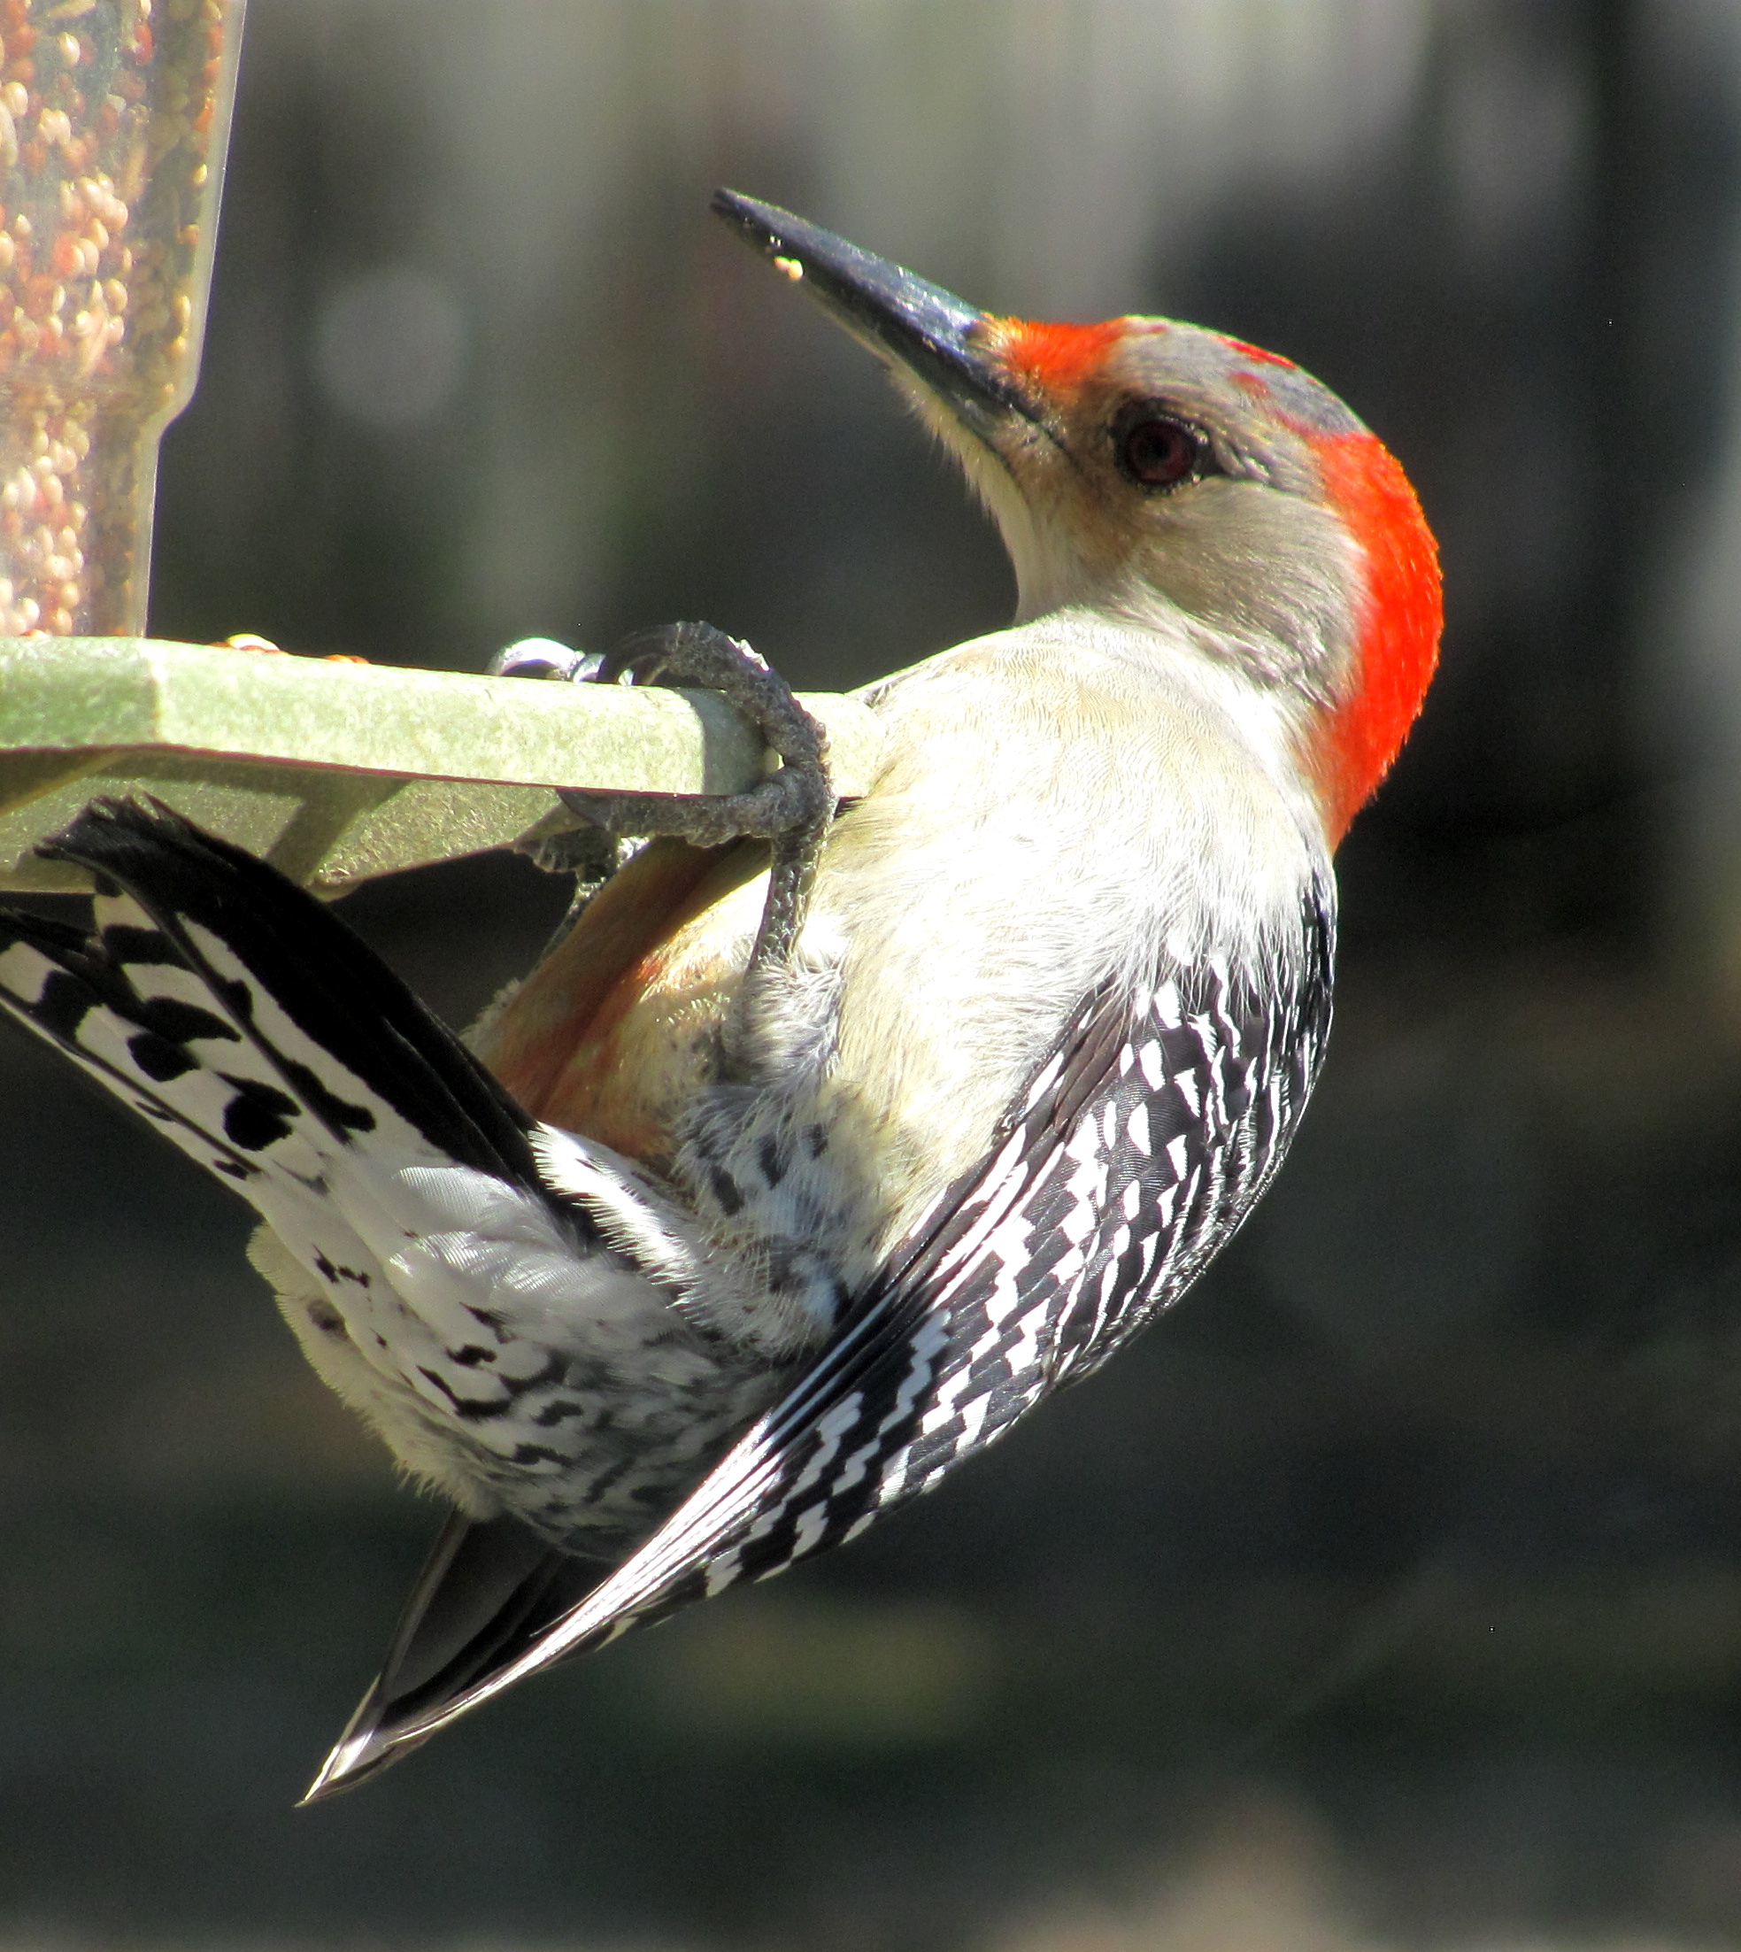
Matthew Henry says,
“While David took care of his father’s flocks, he studied God’s two great books—nature and Scripture.”

Slide 4
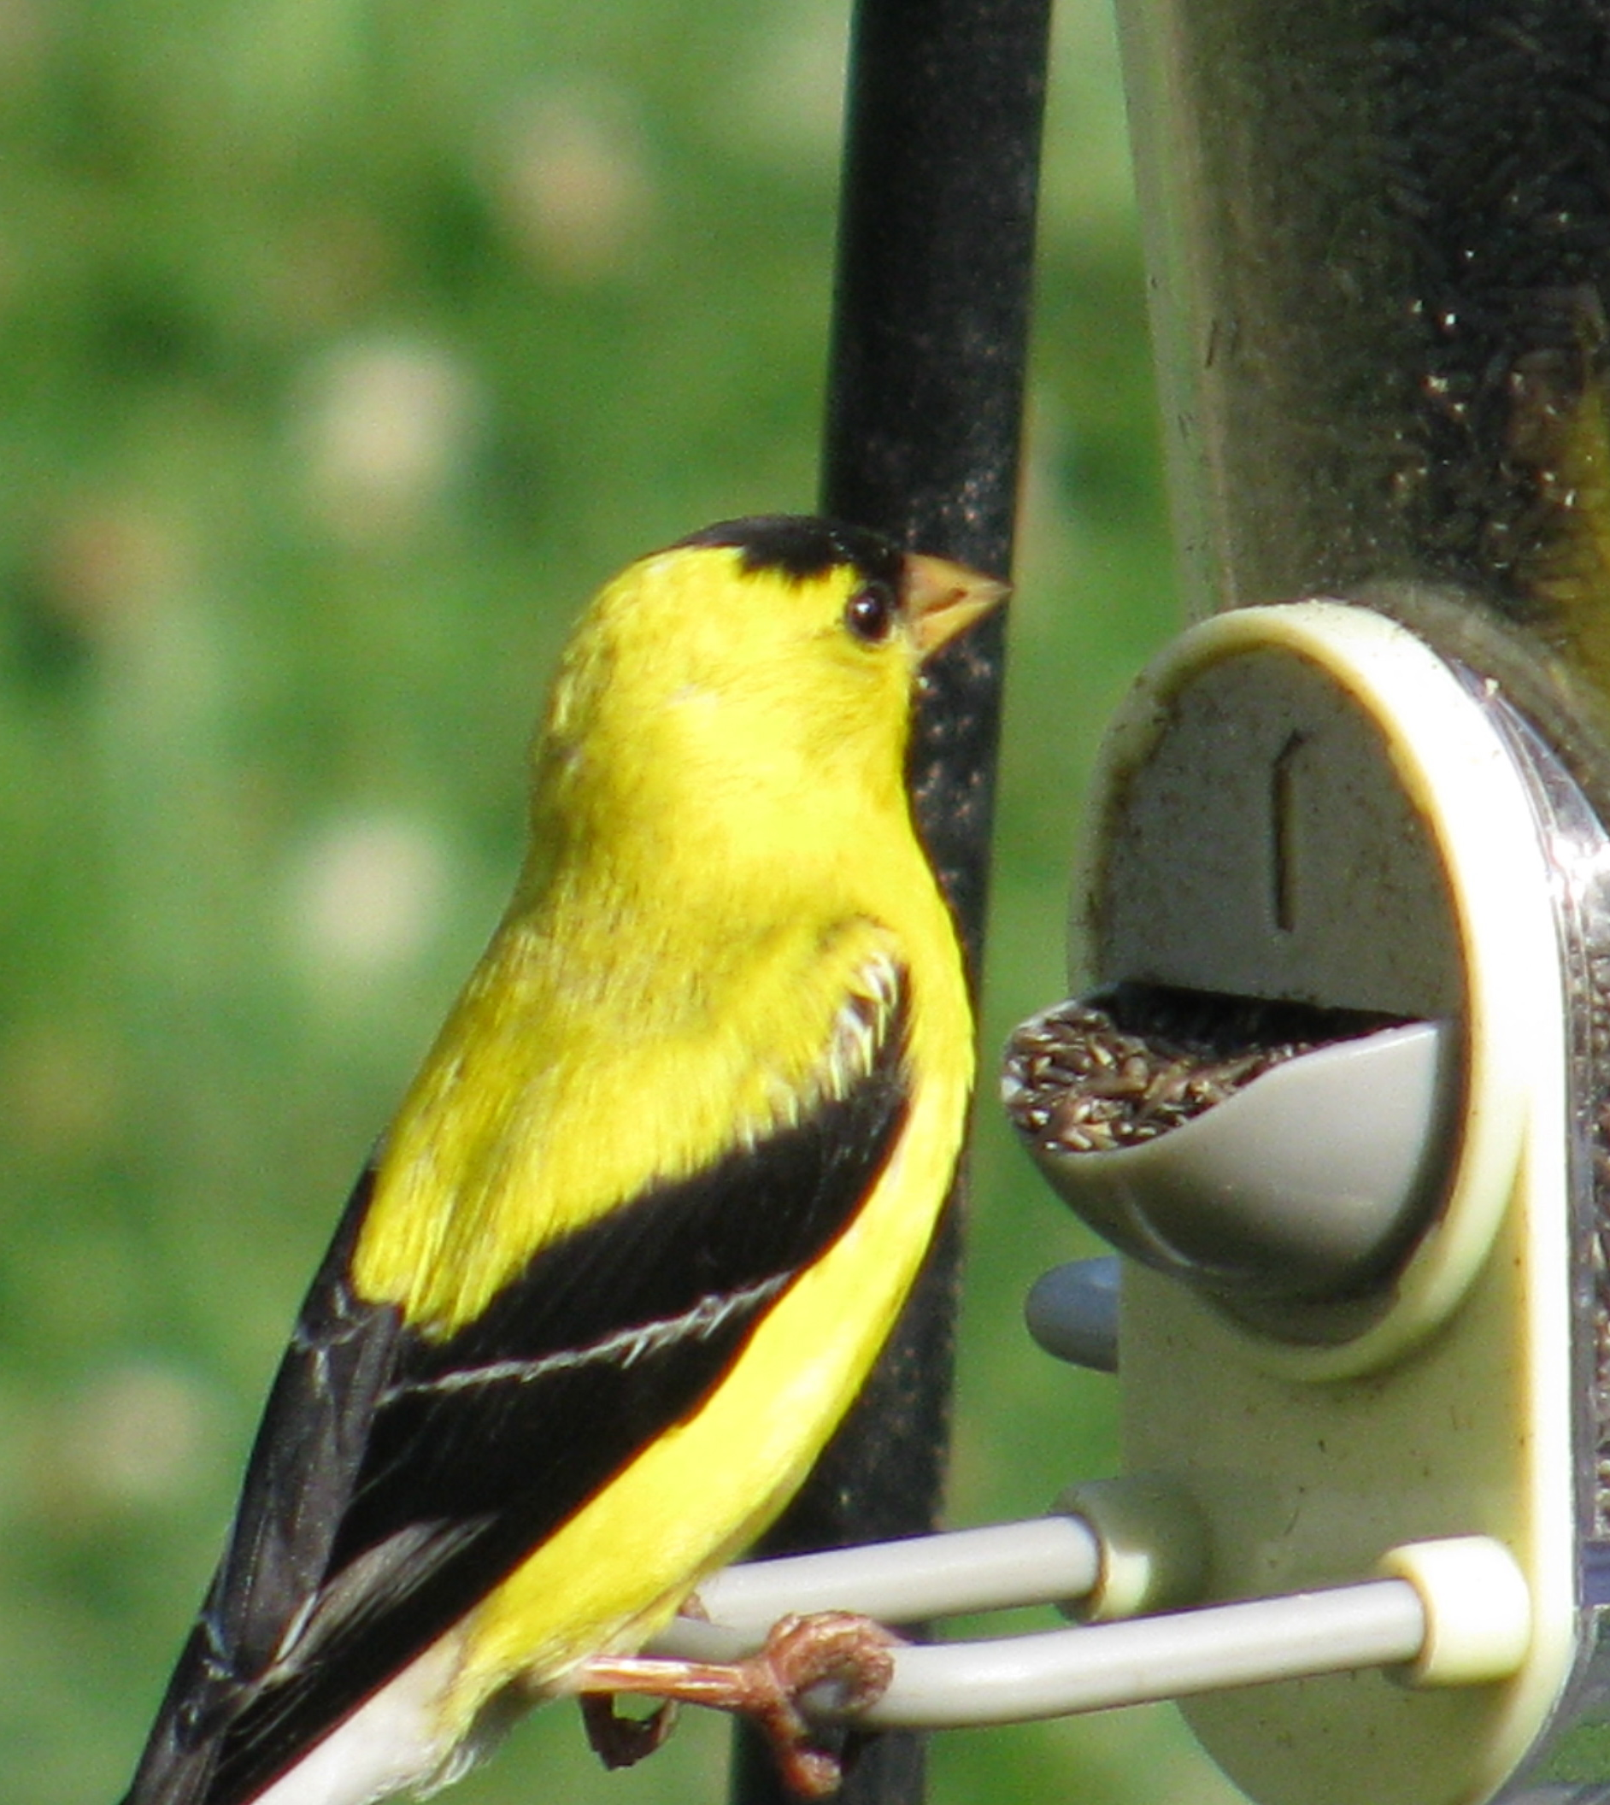
The scriptural pattern for praising God in His creation begins and ends with worshiping Him.

Slide 5
Do you ever wonder how a creepy crawler, a killer whale, or a cactus can praise Him? Yet the command is clear in Psalm 69:34.

Slide 6
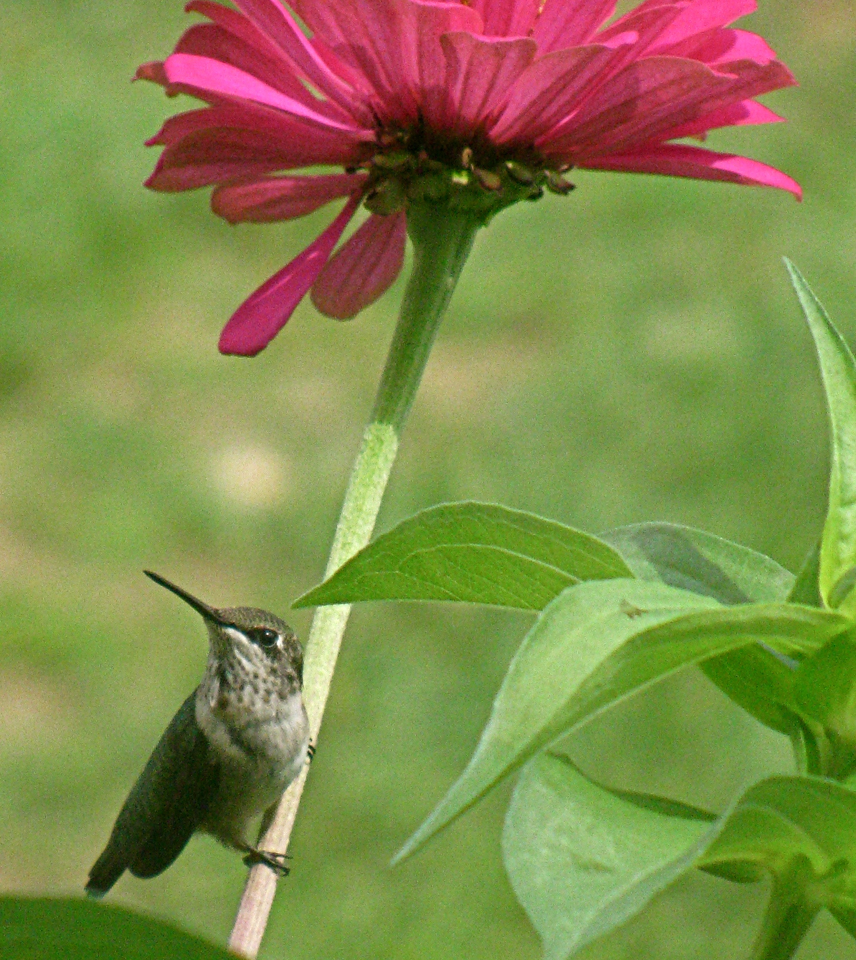
Why were we created? For Him! You are unique, one of a kind, created for His glory.

Slide 7
Isaiah 42:8
I am the LORD: that is my name: and my glory will I not give to another, neither my praise to graven images.

Slide 8
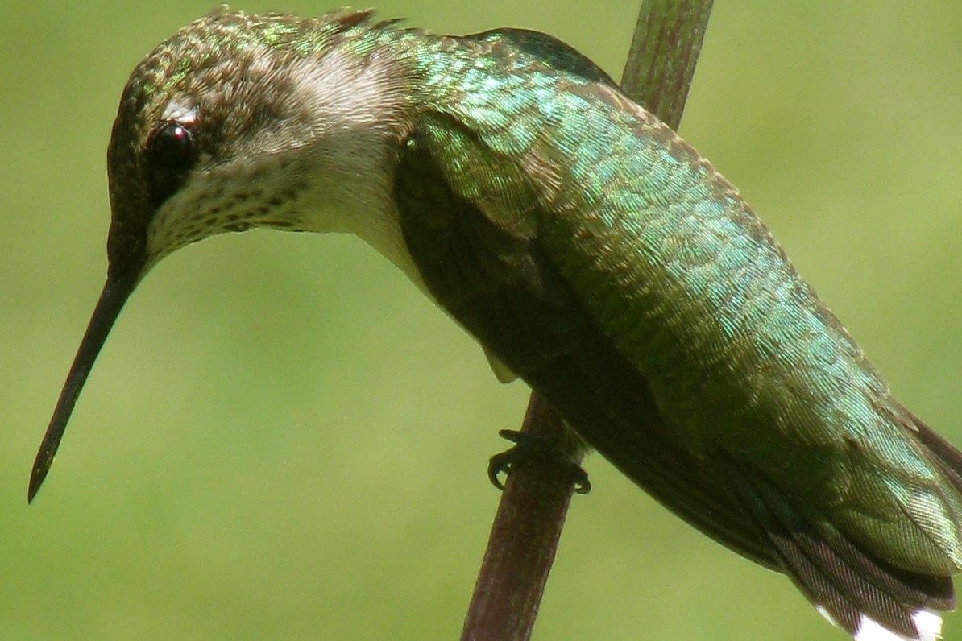
Our hope and strength are in the Lord, not in what He made.

Slide 9
Ivorian believers who had once worshiped fetishes and idols wanted to burn them immediately after their salvation. They knew instinctively that they could not worship the Creator and the creation.

Slide 10
Feeding the birds often reminds me of how God supplies my needs.
Give examples of how God used objects in His creation to teach or strengthen you.

Slide 11
Why doesn’t our world fall apart?
God is the supernatural glue that holds it all together.

Slide 12
Isaiah 40:26
Lift up your eyes on high, and behold who hath created these things…..by the greatness of His might, for that He is strong in power.

Slide 13
Psalm 150:6
Let every thing that hath breath praise the Lord. Praise ye the Lord.

Slide 14
Doxology
Praise God from Whom all blessings flow; Praise Him all creatures here below; Praise Him above, ye heavenly hosts; Praise Father, Son and Holy Ghost.

Slide 15
How can we apply these lyrics to our own lives?

Slide 16

In partnership
with….

