Slide 1

Praise Him in Joyful Times

Slide 2
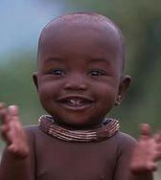
Praising God is not just a formal, structured occasion. Throughout the psalms we are reminded to bless the Lord and praise His name.

Slide 3

We are commanded to praise the Lord --- in all things ….as long as we have breath.

Slide 4
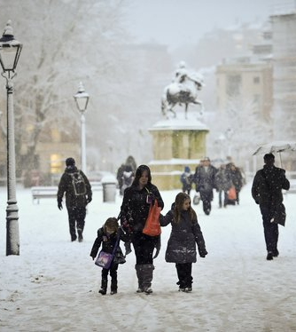
Psalm 121:1
There are always times when we need help. We can rejoice because God does not sleep.

Slide 5
The God who made heaven and earth can move heaven and earth to come to your rescue.

Slide 6
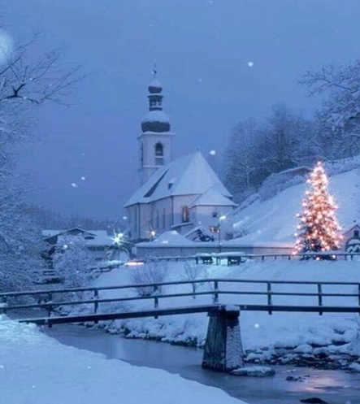
Hebrews 10:24-25
Meeting with God’s people is an occasion for rejoicing.

Slide 7

Psalm 126:3, 6
It is appropriate for us to rejoice when restoration occurs in our lives

Slide 8
Psalm 127:1, 3 and 128:3
These psalms identify the home as a blessing of God. Your family is a reason to rejoice. No family is perfect. So regardless of your home situation, God has blessed you…..rejoice.

Slide 9

Psalm 130:5
The word “wait” carries the connotation of to expect, look eagerly for, to hope. This is more of an anticipatory situation than a dreaded one. Definitely a time of rejoicing.

Slide 10

Psalm 133:1
We can rejoice that God has called us to work together as the body of Christ to accomplish the mission He has called us to do---win others to Christ.

Slide 11
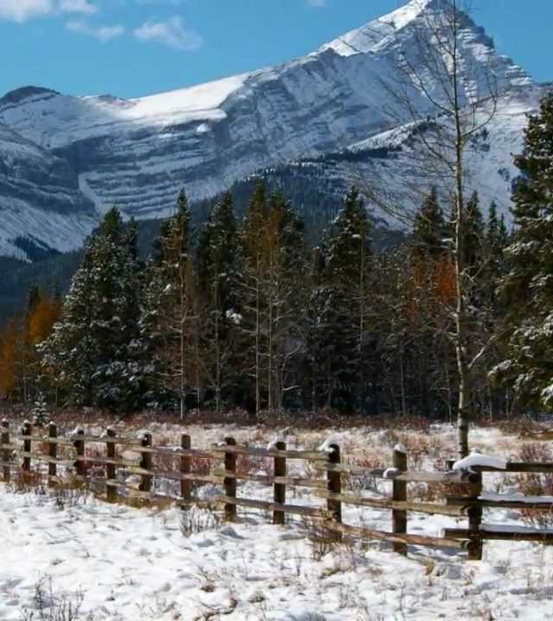
Psalm 134:1-3
God created it all and is our source of blessing. This fact alone is a great motivation for rejoicing.

Slide 12

In partnership
with….

