Slide 1

Praise Him in Loneliness

Slide 2
The world’s greatest tragedy is unwantedness; the world’s greatest disease is loneliness.
Mother Teresa

Slide 3
Types of loneliness:
Interpersonal
Social
Cultural
Intellectual
Psychological
Existential

Slide 4
Which three types of loneliness did David experience in Psalm 142?
(1)
(2)
(3)

Slide 5
Psalm 142
It is believed David wrote this psalm during the time he was being chased by King Saul.
(1 Samuel 22-24)
David cries out to God because he was alone and only God could hear and help him.

Slide 6
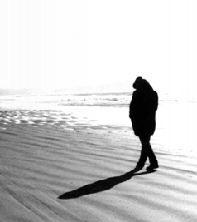
David discovered strength to praise God during this difficult time in
his life.

Slide 7

Helen Keller
A sense of isolation enfolds me like a cold mist as I sit alone and wait for life’s shut gate.

Slide 8
Lesson Learned
A man after God’s own heart, David trusted God for deliverance out of his cave of loneliness.
We, too, can trust God to deliver us out of ours.

Slide 9
What type of witnesses are we to the world if they observe us putting more of our trust in earthly refuges and not in the eternal refuge of a living God?

