Slide 1
2012 Convention Memphis, TN

Slide 2
Theme for
2012-2013
I Peter 5:6-7

Slide 3
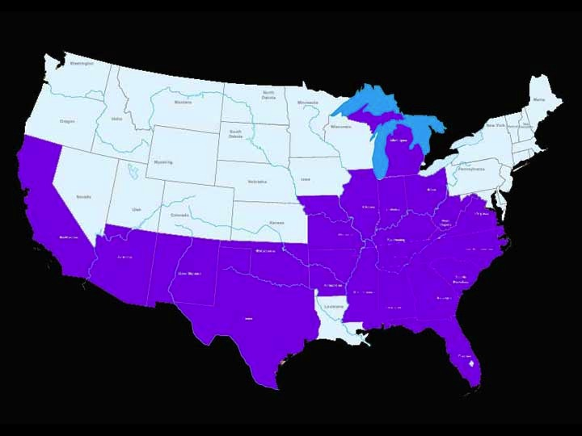
4,716 members from 22 states

Slide 4
$382,991.70 was given by our women. (cash gifts)
Another $23,687.74 was given in non-cash items for the provision closet.
$406,679.44 was given to missions and ministry causes (78%)
Grand total: $523,565.20
$73,074.45 was sent directly to the specific ministry and then reported to WNAC (Aug.-Dec.)
Use large $

Slide 5
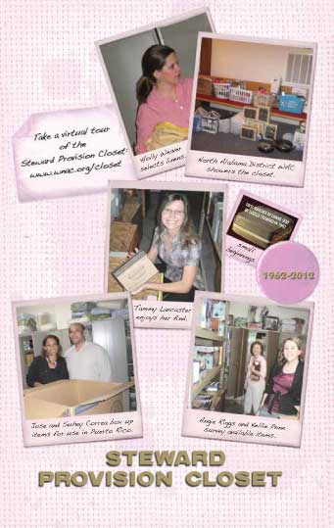

Slide 6
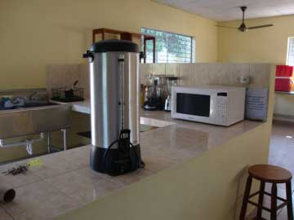
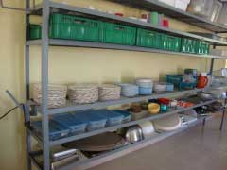
Items contributed to the Chame’ Institute for the 50th celebration
Industrial coffee pot
Plates and silverware

Slide 7
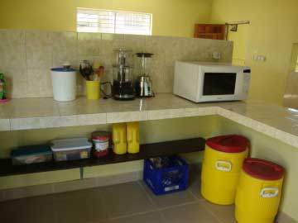
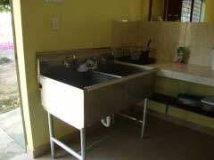
Prep Sink and Food Processor

Slide 8
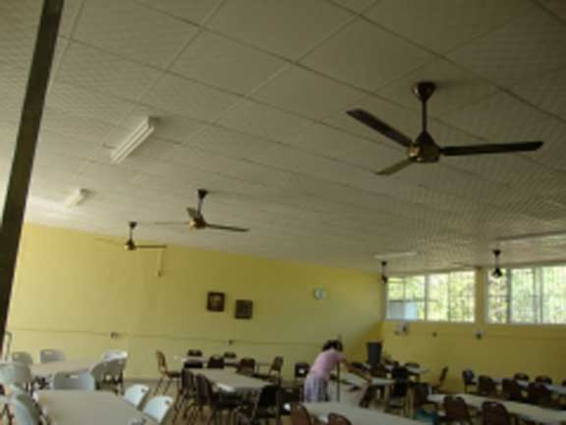
Ceiling Fans for the Dining Hall

Slide 9
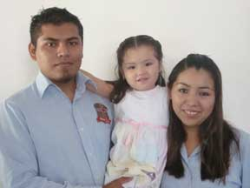
Cleo Pursell Foreign Student Scholarship Fund (2011)
Esther
Gabriella

Slide 10
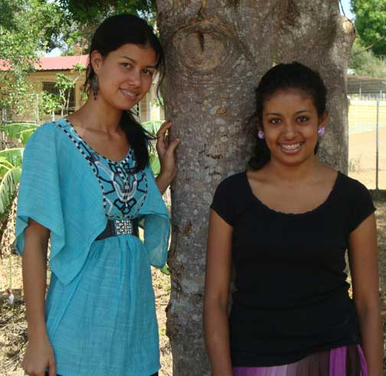
2012 Recipients
Elisa (L)
Cynthia (R)

Slide 11
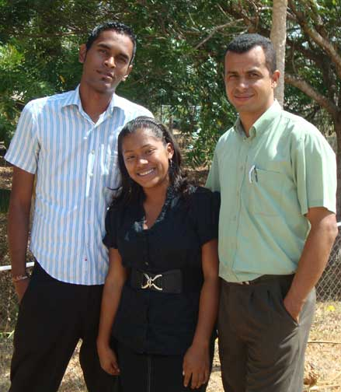
Stephanie

Slide 12
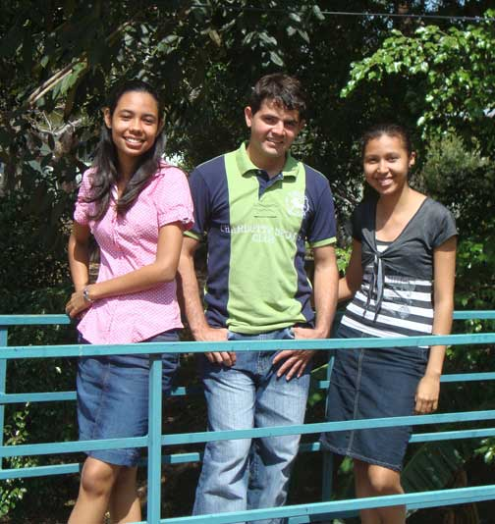
Báderlin (L)
Liz (R)

Slide 13
Dr. Mary Ruth Wisehart

Slide 14
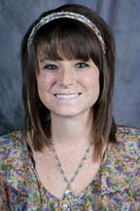
Bre Reierson Hillsdale

Slide 15
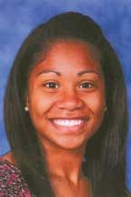
Dominque Ward,
Southeastern

Slide 16
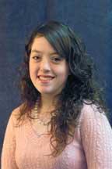
Jessica Barrow,
Gateway

Slide 17
QR Code

Slide 18
WNAC Survey
Conducted fall of 2011
State officers invited to participate
48% participation
Plans for the 2012 convention and seminars
Social media feedback
Treasure
Thanks for sharing your thoughts!

