Slide 1



Slide 2
1873
FWB Female Missionary Society organized
Authorized to receive funds and send missionaries
Turned over its assets to the American Baptist group in 1920…..group with which the northeastern FWB had merged

Slide 3
1899
Earliest record in the south
Glennville, GA mentions an auxiliary
“Sisters” had contributed
$5.95 to the pastor’s annual
salary.

Slide 4
1910
Following the merger, local groups continued to work for the cause of Christ.
Used various names:
    Missions
    Women’s Work
    Ladies’ Aid Society
    Women’s Missionary Society and Auxiliaries

Slide 5
1920 – 1935
No national organization
FWB were alive in the southeast, southwest, and midwest.
Women in TX, MO, OH and NC had supported the organization in the northeast.

Slide 6

June 13, 1935
Black Jack FWB Church in Pitt County, NC
Organized a national FWB women’s organization
Chose the name….Women’s National Auxiliary Convention (WNAC)
Approved by the National Association in November, 1935

Slide 7
5 Basic Things
Watchword: “Laborers together with God” (II Corinthians 3:9)
Purpose: We are women seeking to fulfill the Great Commission through our God-designed roles in our homes, churches, communities and the world.

Slide 8
Definition: a service organization of the church
Hymn: “People Need the Lord”
Colors: Lavender and white

Slide 9
Organization
Local
District
State
National

Slide 10
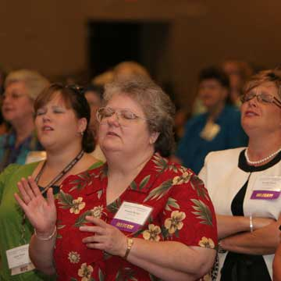
Officers
Coordinator/ president
Assistant Coordinator/ vice president
Secretary
Treasurer
Prayer/missions chairman
Service chairman
Study chairman

Slide 11

State/ National
Field Workers
Members – at- Large

Slide 12

Weeks of Prayer
World Missions Offering
    April
    International Missions
Mission: North America
November
Home Missions
Alice Lupton….state missions

Slide 13
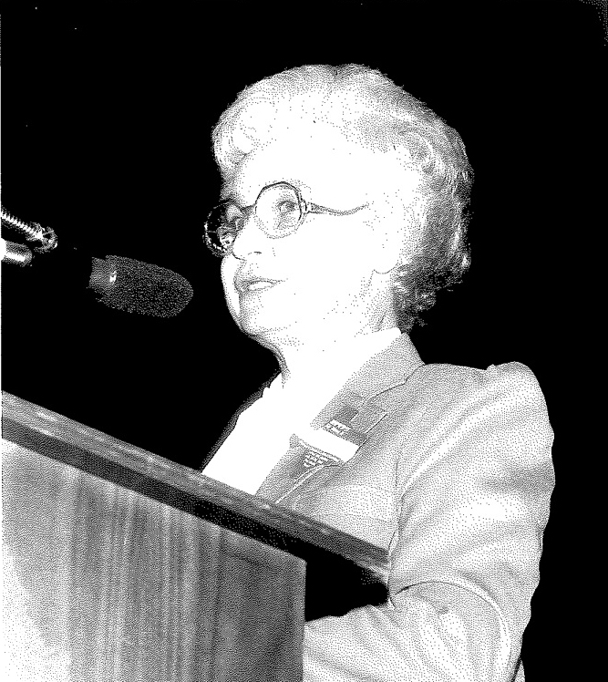
Cleo Pursell
Foreign Student Scholarship Fund

Slide 14
History was made in 2010…4 ladies
$1799.50 total received
$449.88 each…..education $25/month
18 of the 20 month program

Slide 15
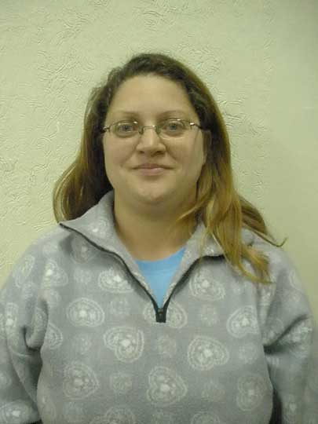
Adriana Evangelista da Silva (children’s church leader, S. Jose Church)

Slide 16
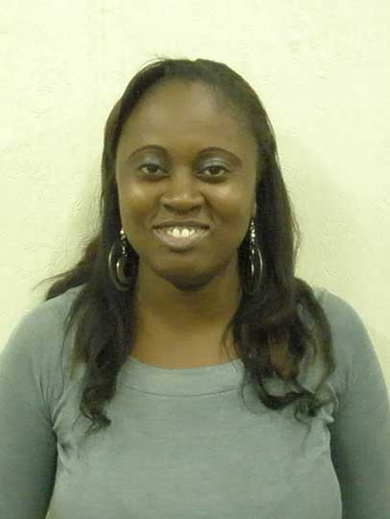
Alexsandra de Paula
(worker, S. Jose Church)

Slide 17
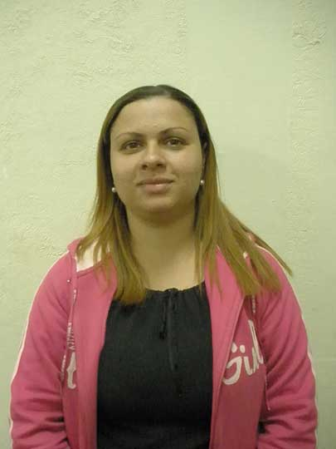
Ana Paula de Carvalto,
(pastor’s wife, Nova America Church)

Slide 18
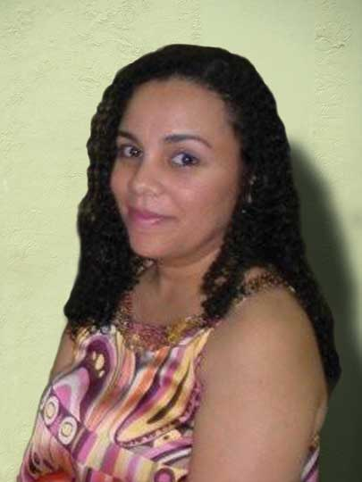
Daniela Emiliano
(pastor’s wife, Ipiranga Church)

Slide 19


Slide 20
$53,592.28….
total received
$17,864.09…each

Slide 21
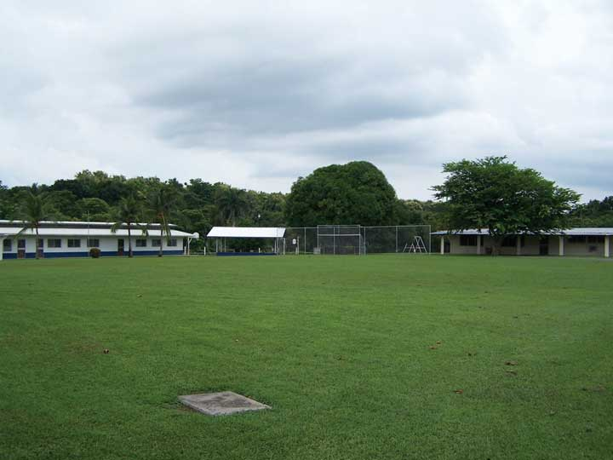
Chame Institute
(Panama)

Slide 22
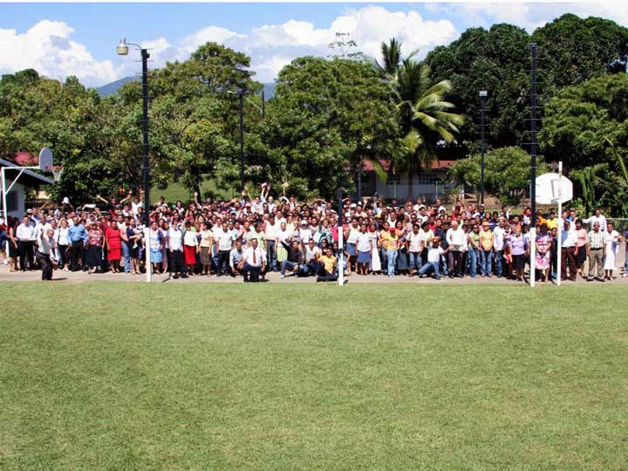
Chame in use

Slide 23
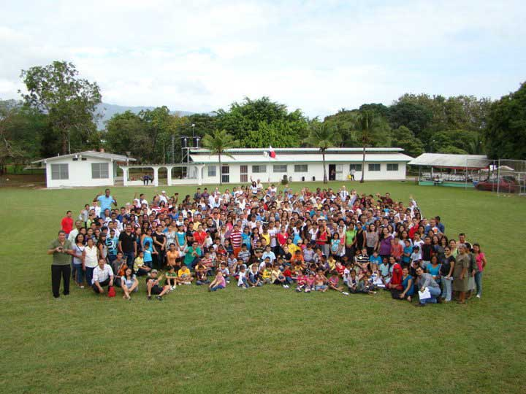
Panama’s National Convention

Slide 24
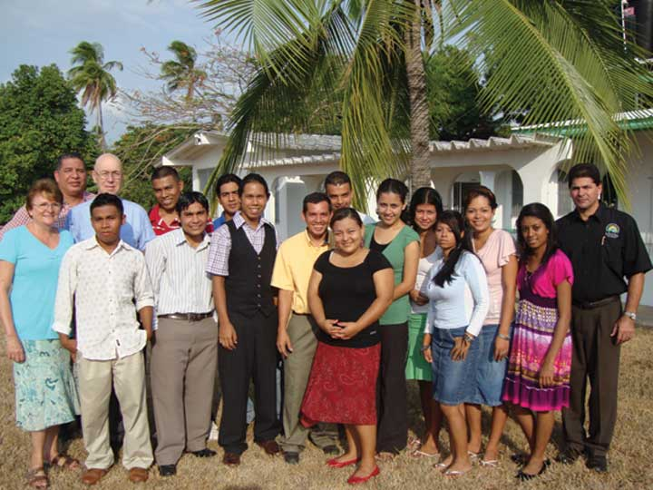
Chame Students

Slide 25
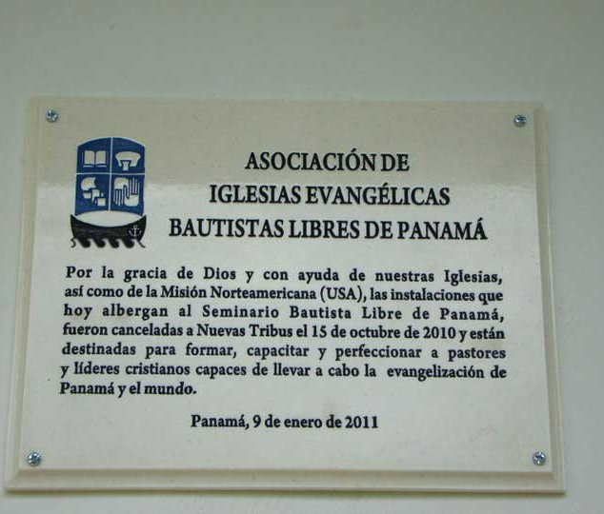
Chame’s Dedication
(1-9-11)

Slide 26
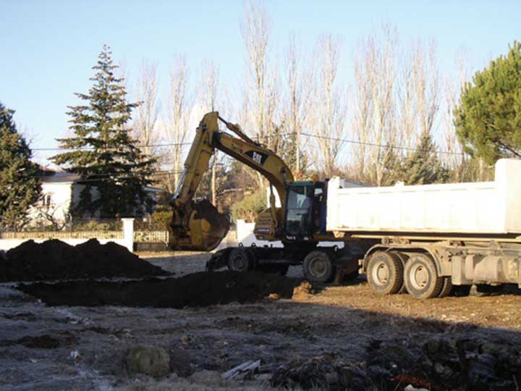
Villalba, Spain

Slide 27
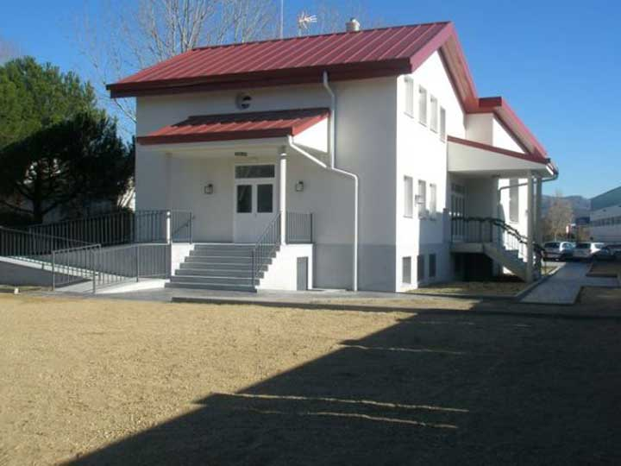
Completed!

Slide 28

SHINE 75
National project
Adopted in 2010
Raise $75,000
$25,000 each for the 3 Hispanic Institutes
Gwen Hendrix (Inman, SC)
IBLAC (Altimira, Mexico)
Seminary of the Cross (Reynosa, Mexico)

Slide 29
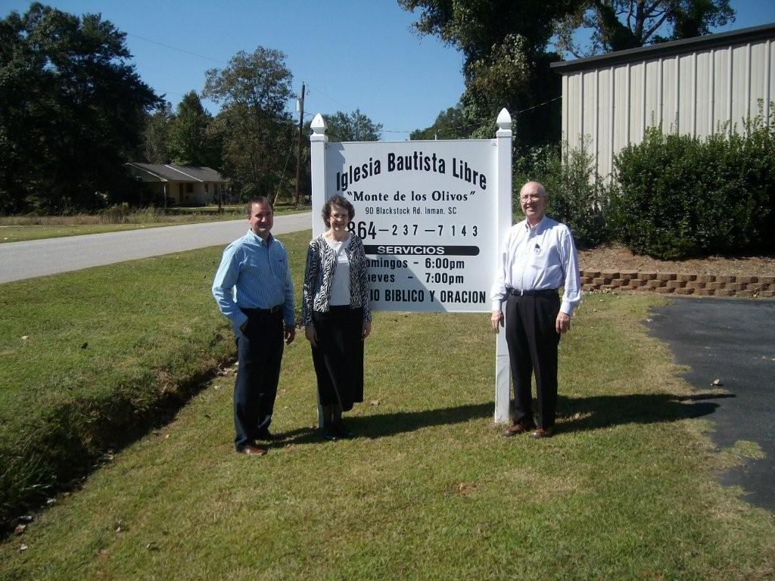
Gwen Hendrix Institute
(Inman, SC)

Slide 30
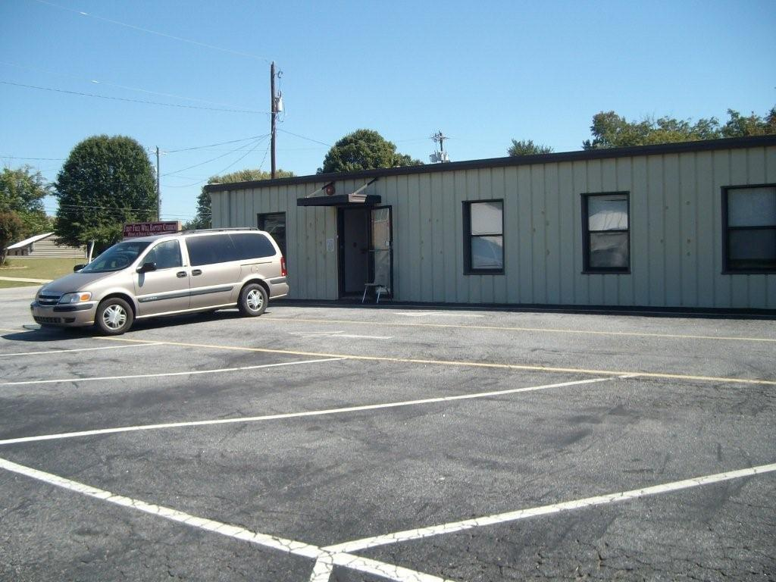
Dorm/ classroom building

Slide 31
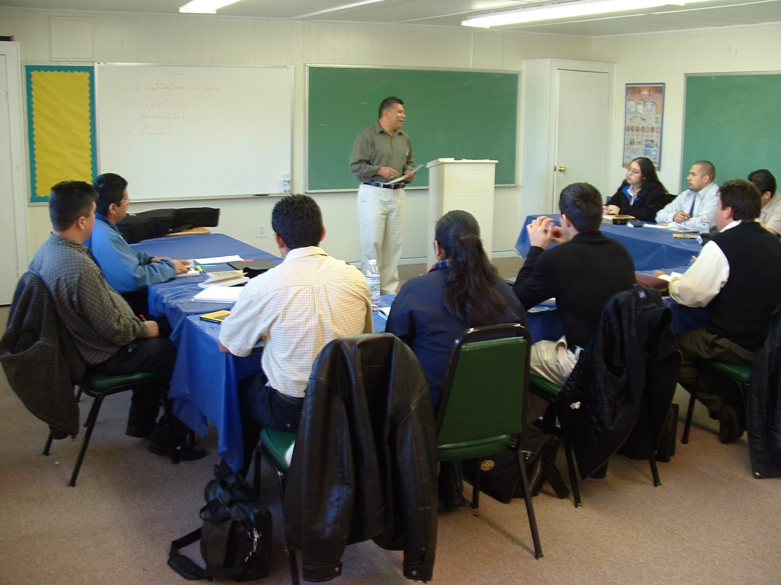
This classroom is at the end of the dorm building. There are usually 12 students.

Slide 32
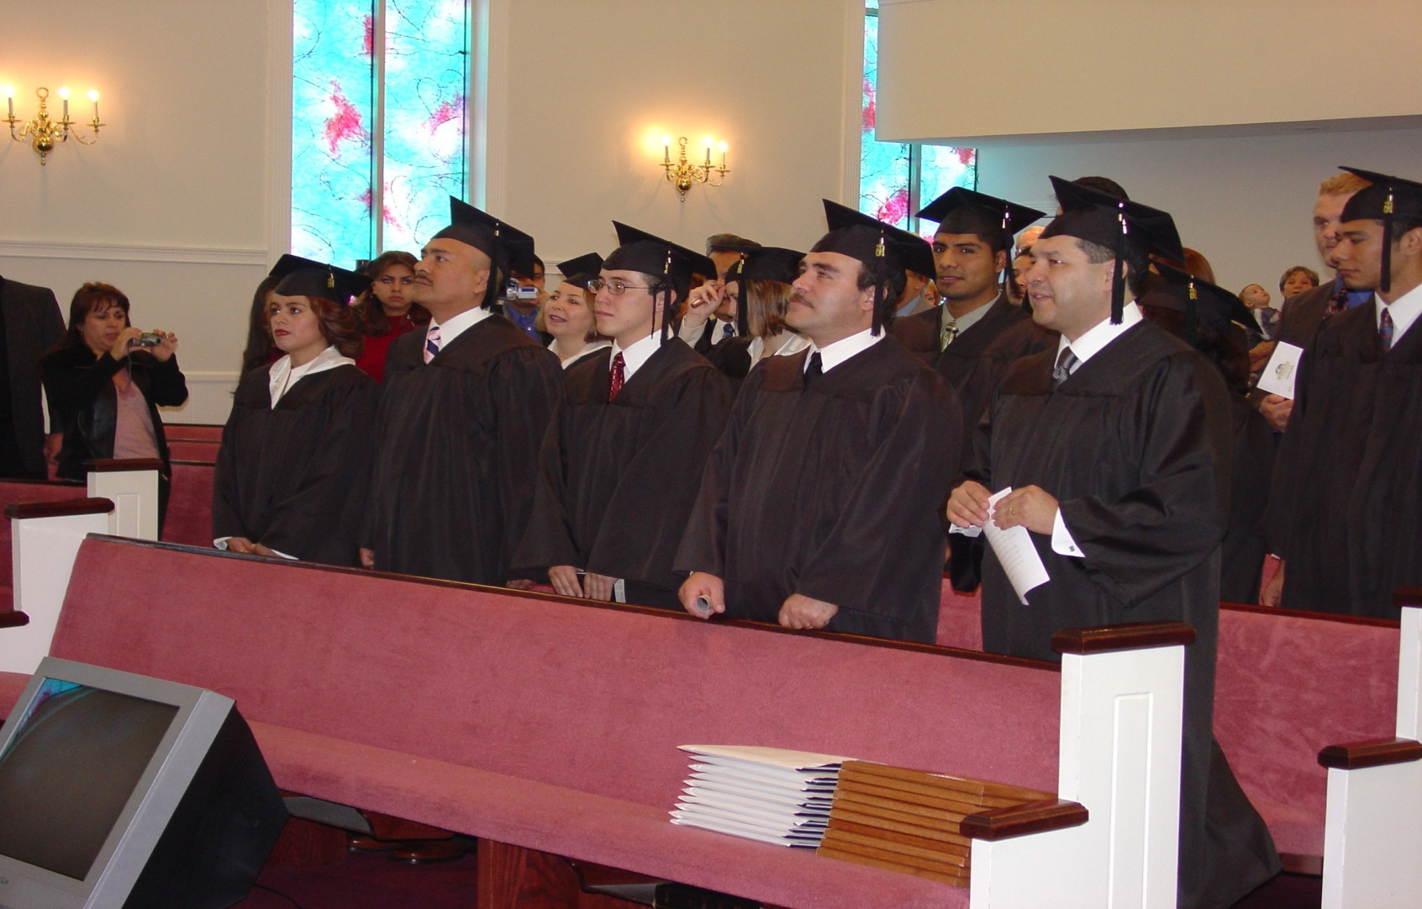
Graduation!

Slide 33
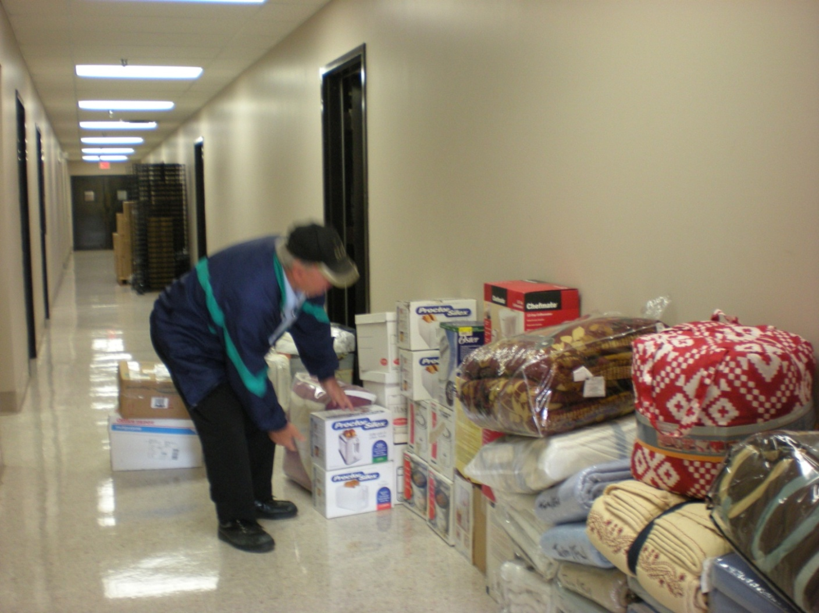
Provision Closet Delivery

Slide 34
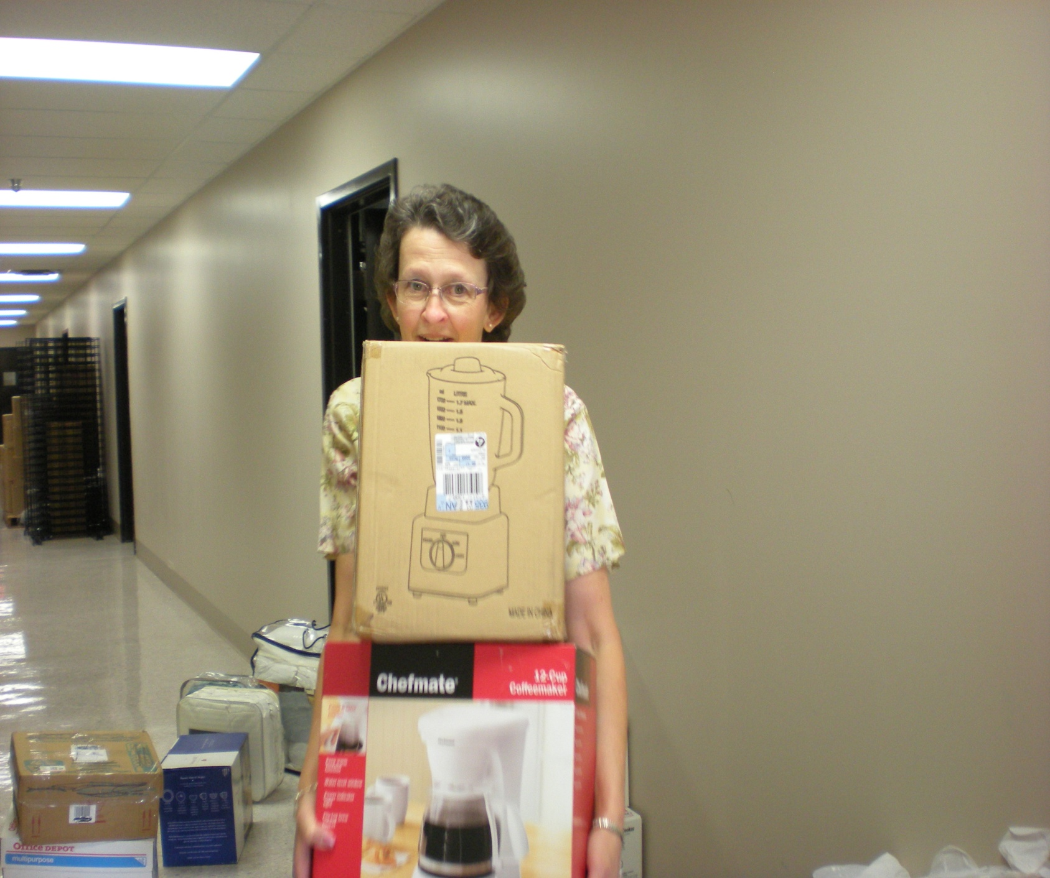

Slide 35
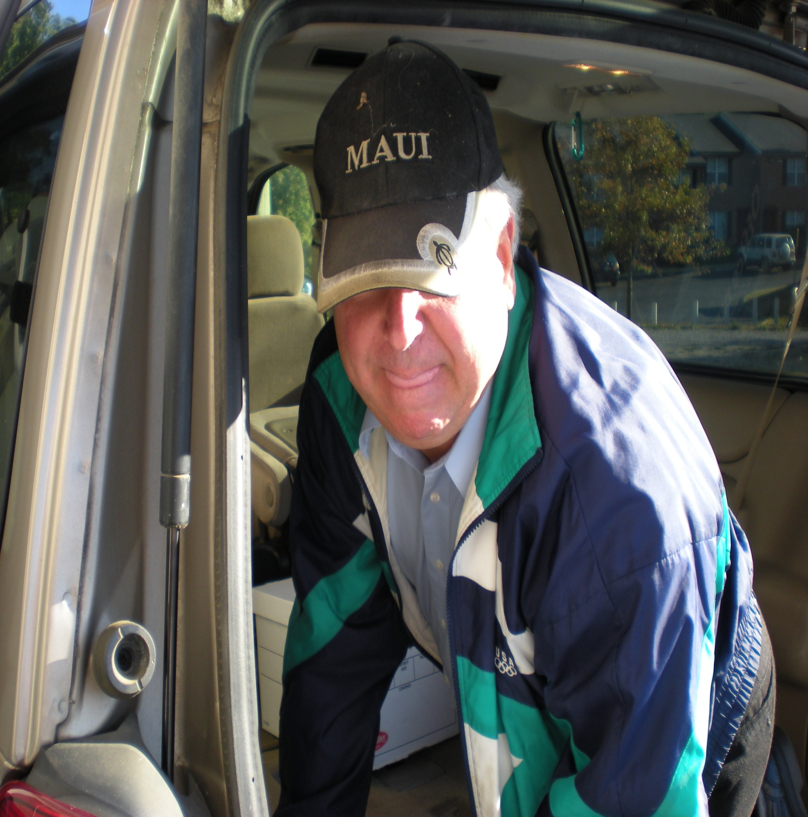

Slide 36
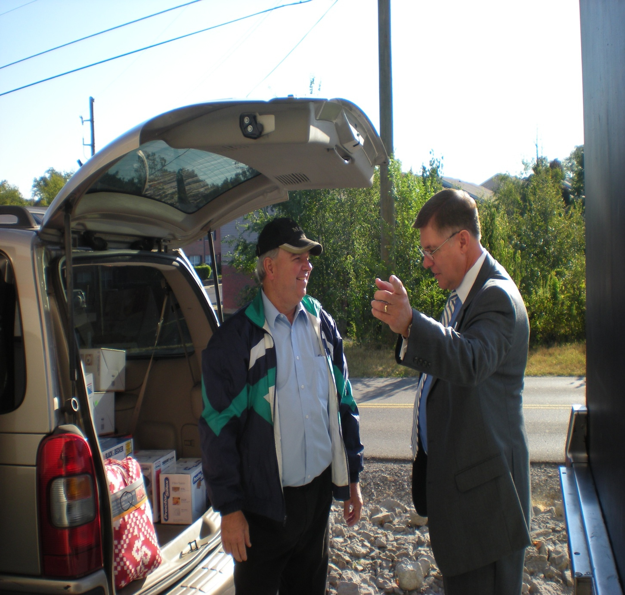

Slide 37
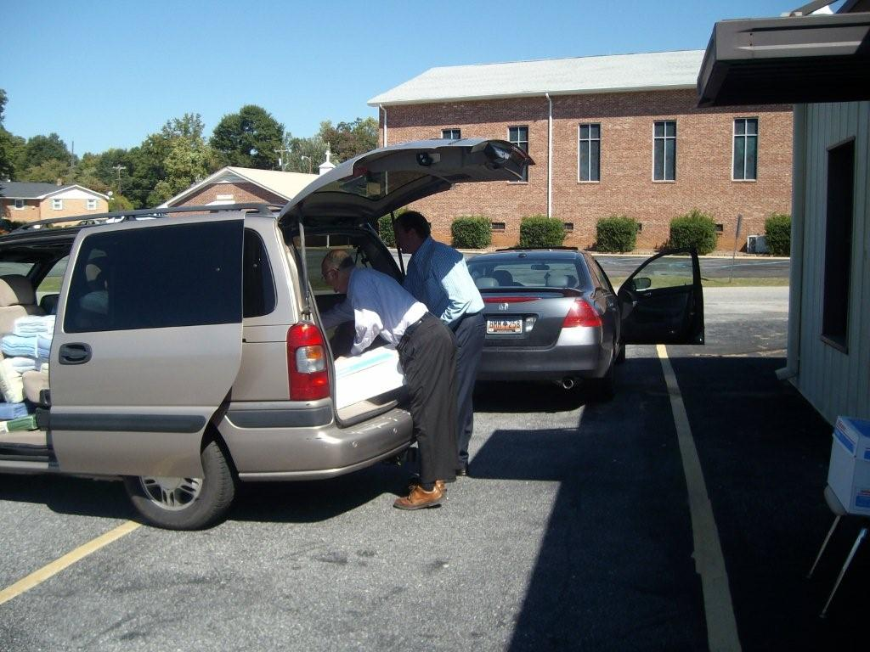
Arrival in Inman, SC
…all hands on deck!

Slide 38
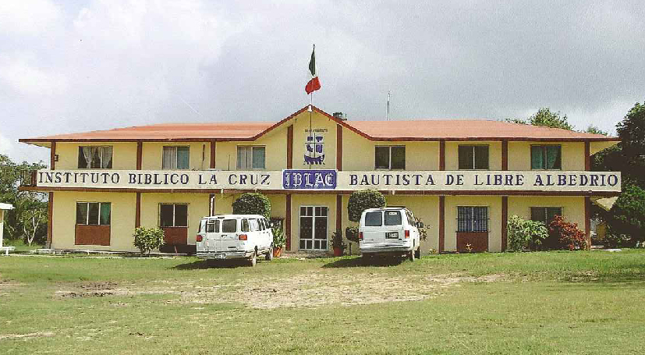
IBLAC
(Altimira, Mexico)

Slide 39
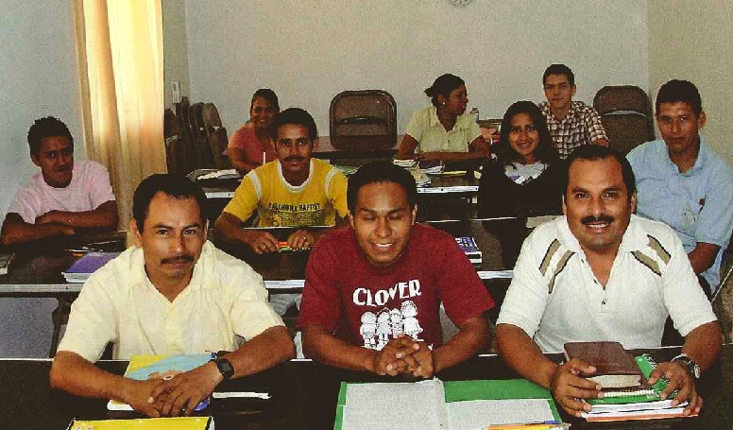
Full-time (day) students

Slide 40
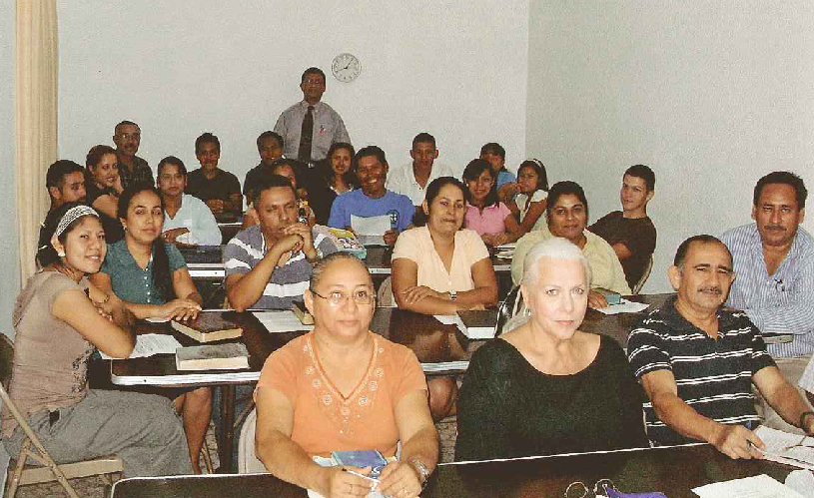
Night Class students

Slide 41
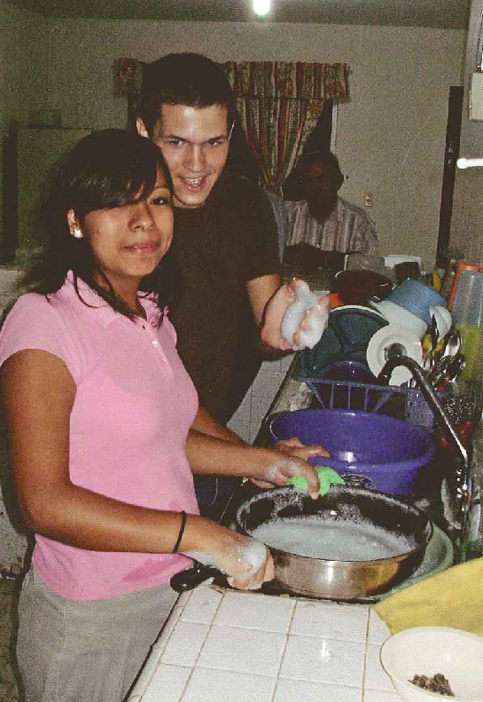
Every student has a job, i.e. washing dishes, working on the grounds, etc.

Slide 42
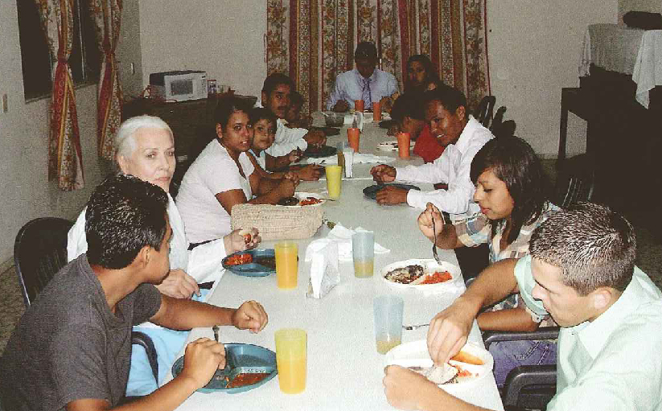
Dinner with Bro. Bud and Mrs. Ruth Bivins.

Slide 43
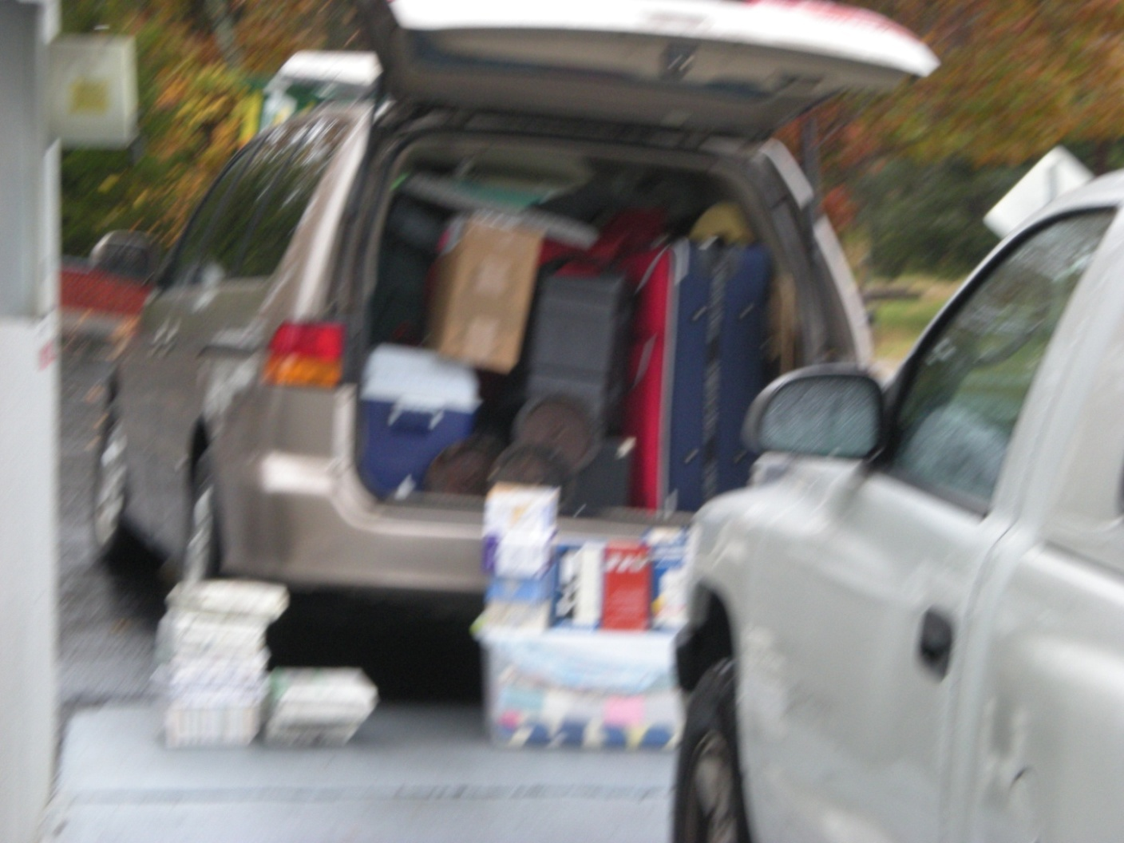
Loading Provision Closet Items

Slide 44
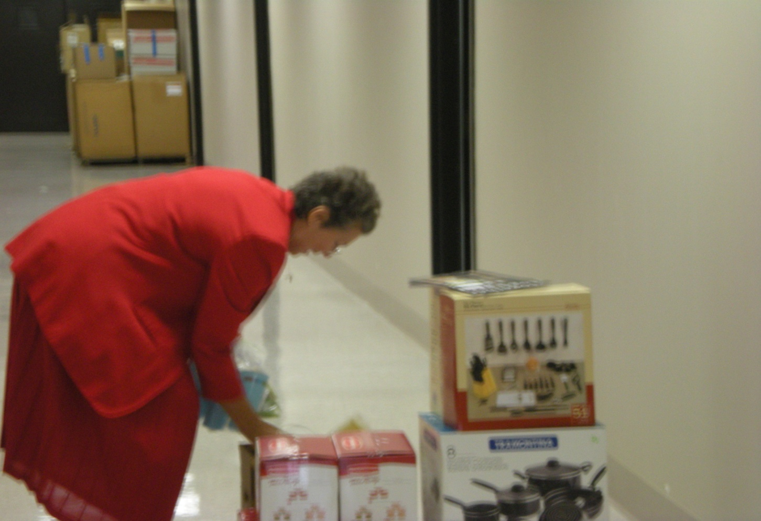
Mrs. Ruth counting blessings.

Slide 45
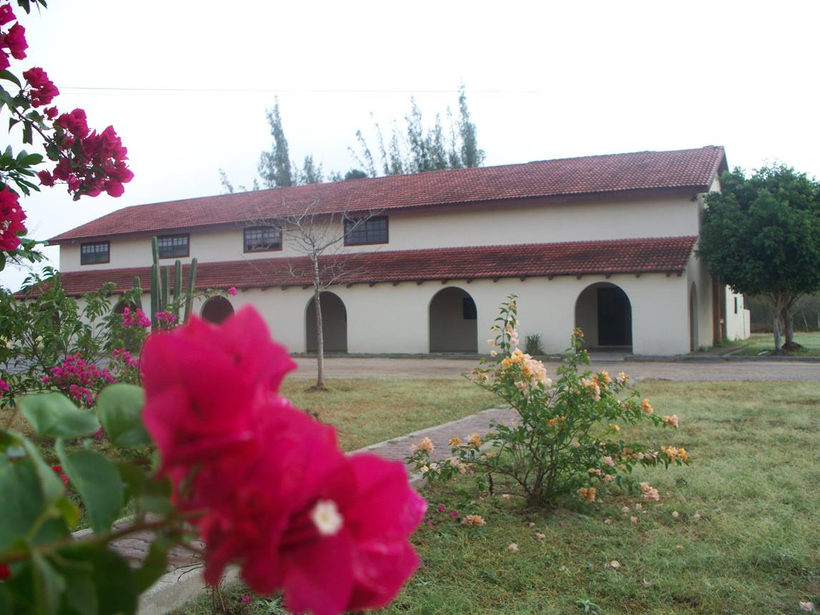
Seminary of the Cross
(Reynosa, Mexico)

Slide 46
$560, 103.32
(missions and ministry causes)

Slide 47
4996 members

Slide 48
To God be the glory great things HE has done!!

