Slide 1




Slide 2
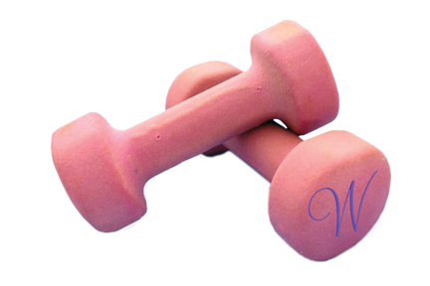

WOMEN NATIONALLY ACTIVE FOR CHRIST

