Slide 1
Ponder
the
Promise
of

Slide 2


Slide 3
WOMEN ACTIVE FOR CHRIST

Slide 4
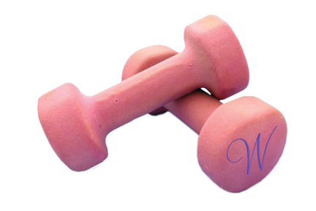

WOMEN NATIONALLY ACTIVE FOR CHRIST

