Slide 1



Slide 2

2011-2012 Theme
Ephesians 4:15-16

Slide 3
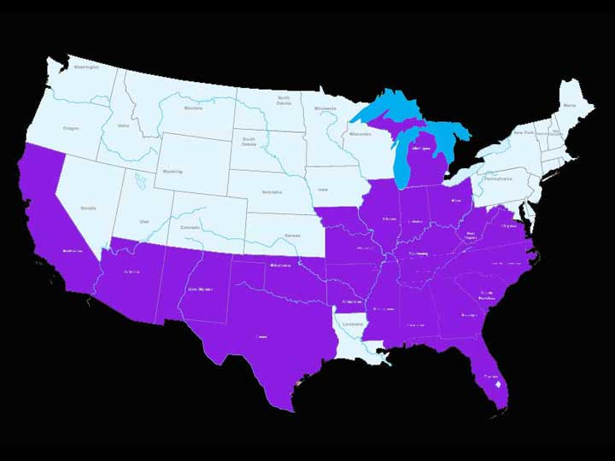

Slide 4


We are part of the
ONE Magazine family!

Slide 5


Our publication has undergone change.

Slide 6


Slide 7

Partnering with Randall House…

Slide 8
Partnering with our colleges
FWBBC… Nashville, TN
Hillsdale… Moore, OK
CCC… Fresno, CA
Southeastern...Wendell, NC
Gateway…Virginia Beach, VA
$1,000
scholarship per year

Slide 9

National
Project…
$75,000

Slide 10
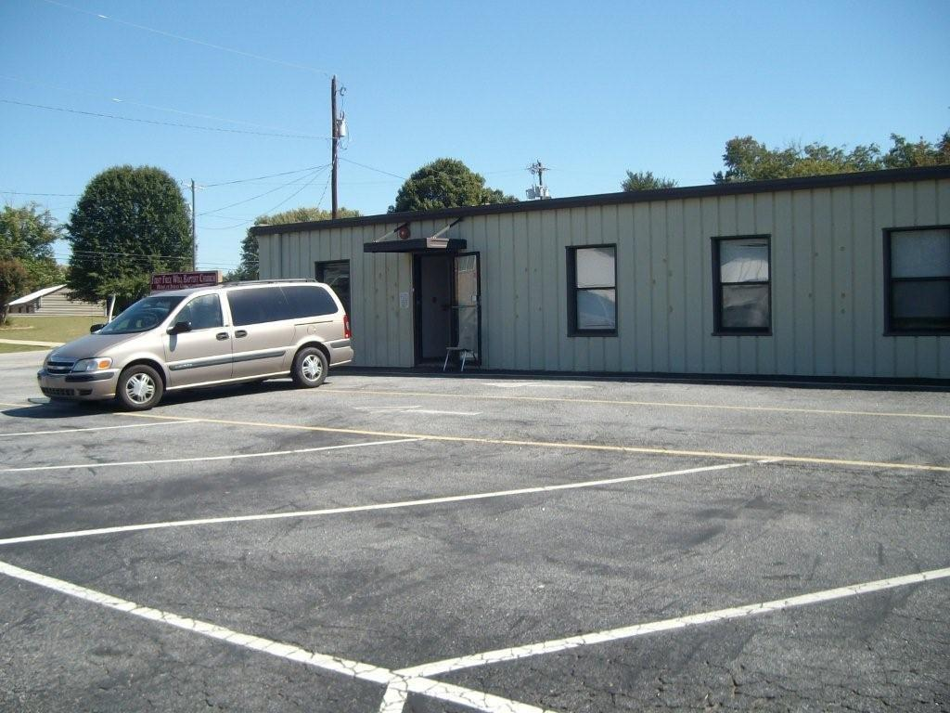
Gwen Hendrix Bible Institute
Inman, SC

Slide 11

$30,000 per semester needed to train these men and women.

Slide 12
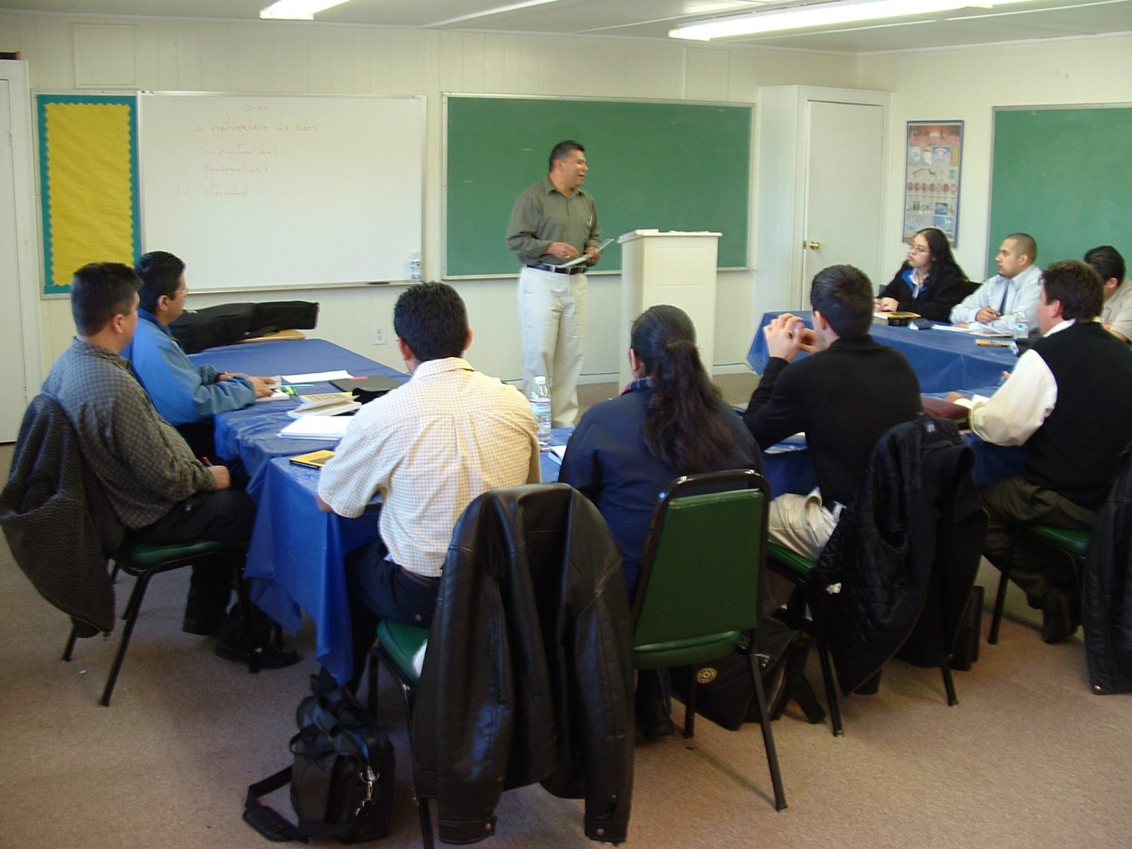

Slide 13
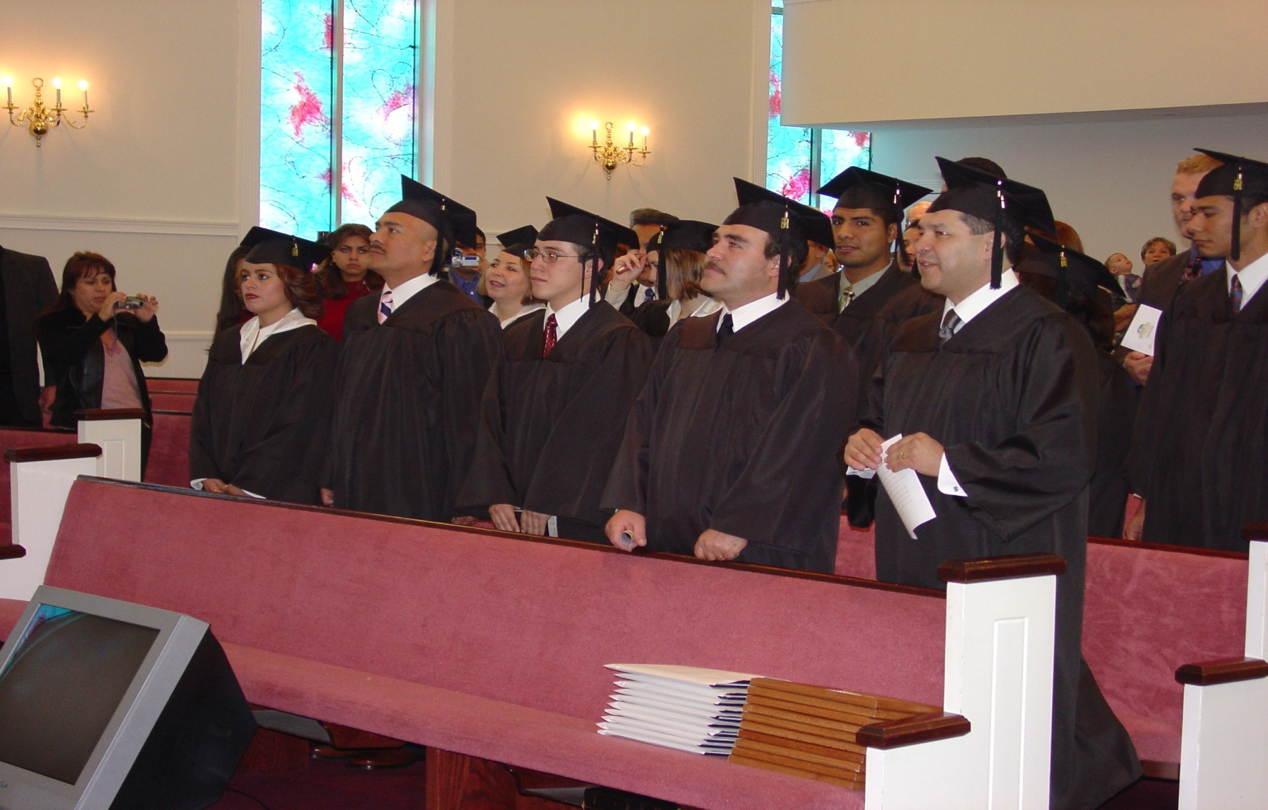

Slide 14
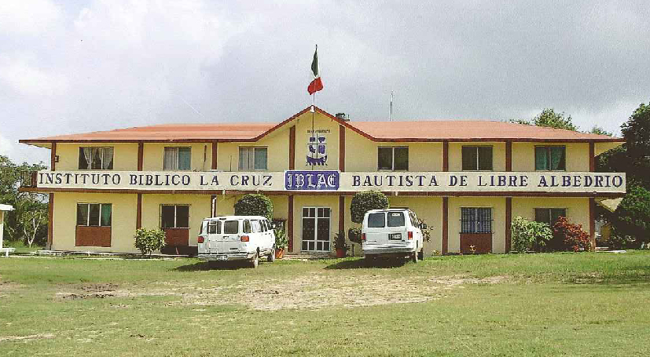
IBLAC
Altamira, Mexico

Slide 15
$28,000 per year needed to train these men and women.

Slide 16
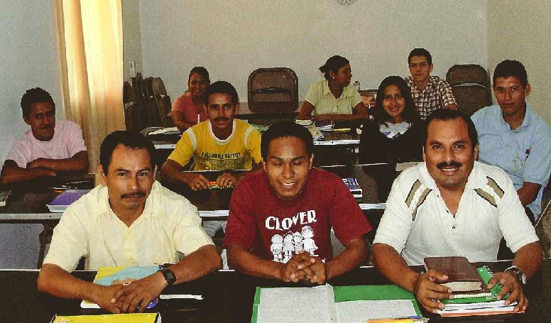
Full-time (day) Students

Slide 17
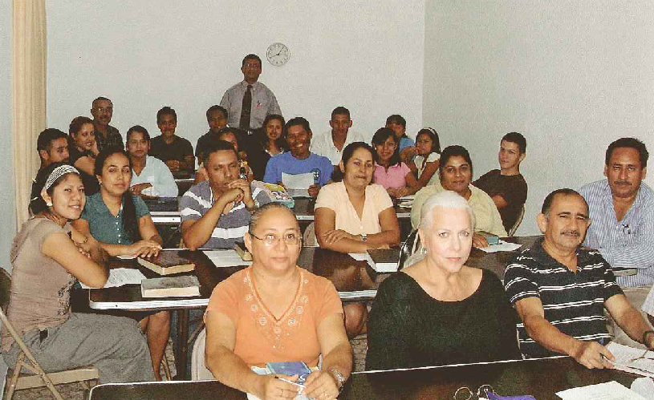
Night Students

Slide 18
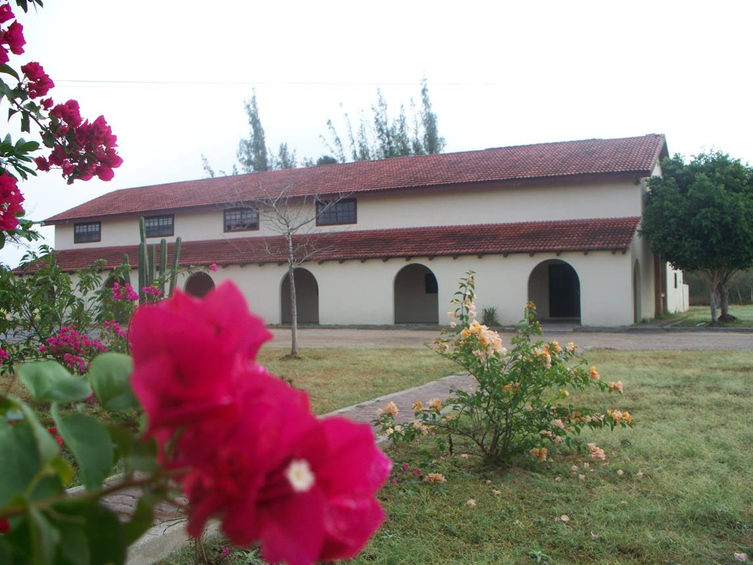
Seminary of the Cross
Reynosa, Mexico

Slide 19
$3,300 per student is needed per year to train these students.

Slide 20
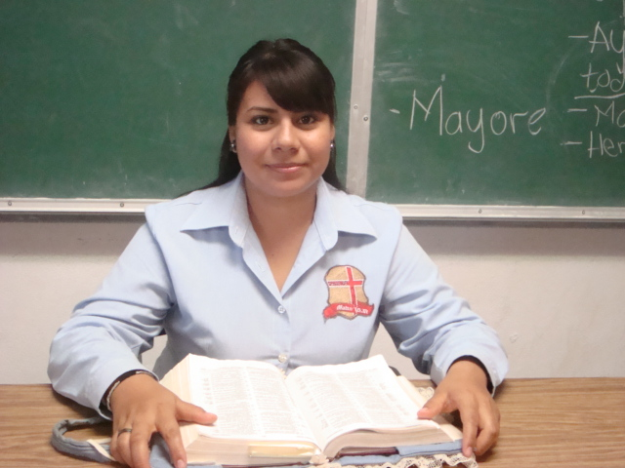
ESTER : a 2011 recipient of the
Cleo Purcell Foreign Student Scholarship

Slide 21
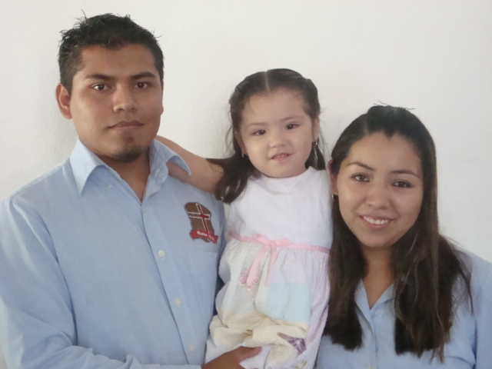
Gabriela with her family: both she and her husband are training in the Institute.

Slide 22
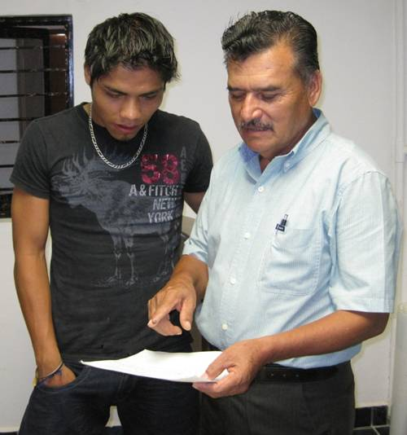

Slide 23
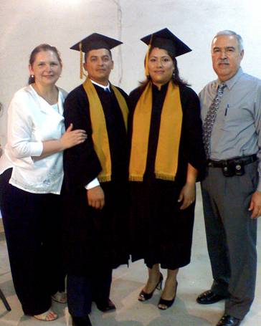
The final step!

Slide 24

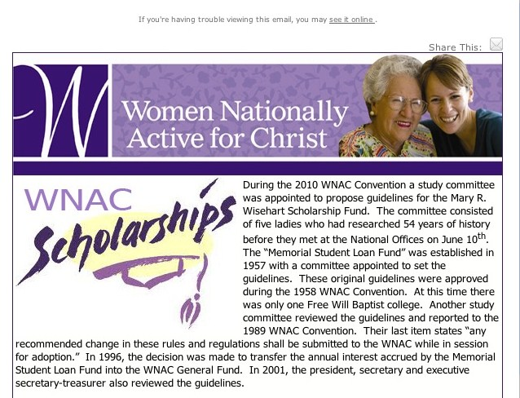
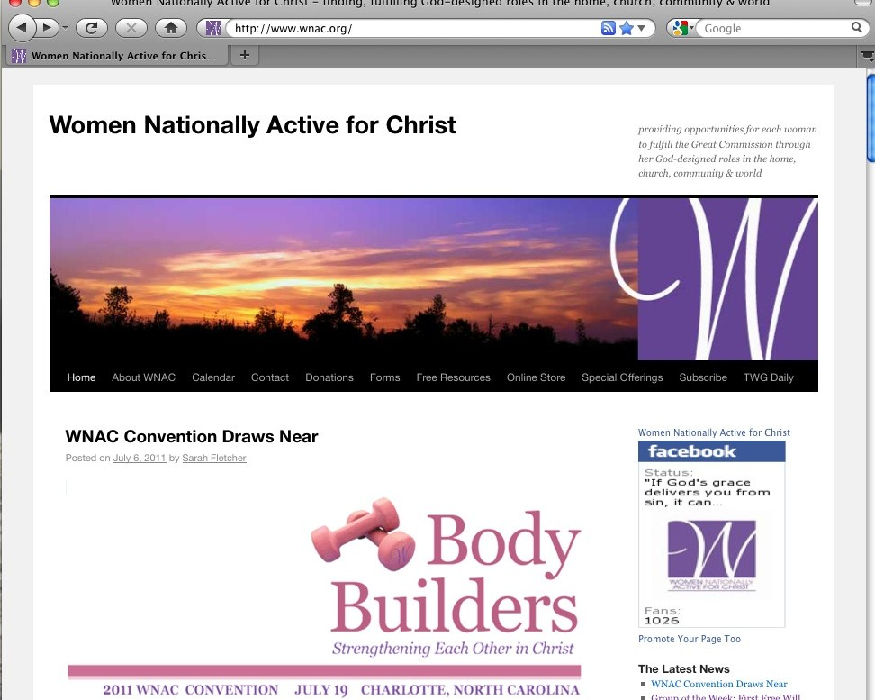

Social Media

Slide 25
Economic Downturn
Sharing an office suite with the
Master’s Men department
Reduced our office staff
  *Share an administrative assistant with MM
  *Contractual editor
Quarterly publication of Treasure
Salaries are frozen for the 2012 budget cycle

Slide 26
$560, 839.38
(missions and ministry causes)

Slide 27

5,109
members
(2% increase)

Slide 28

Global Women
Active for Christ
Myanmar
Cote d’Ivoire
Panama
Cuba
Mexico

Slide 29

WNAC

Slide 30

We value your input…
let us hear from you.

Slide 31
To God be the glory great things
He has done.

